Slide 1




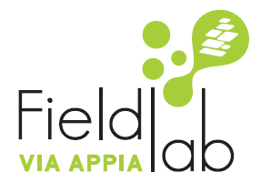


Fieldlab VIA APPIA:
Taking a central approach to using AI for failure prediction
Johan Prinsloo, IMS International BV
6 September 2022, Zwolle
VIA APPIA is also
made possible by:

Slide 2
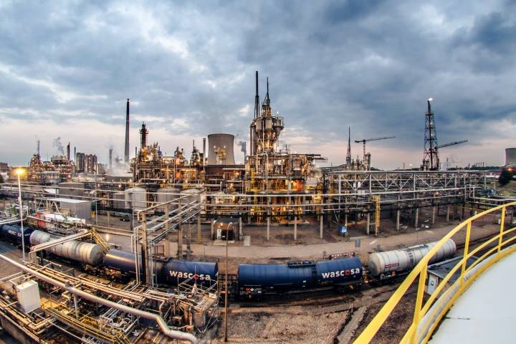
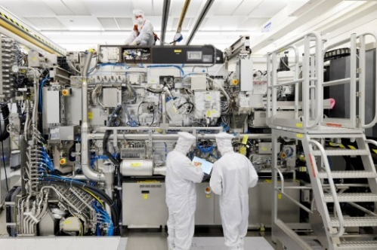
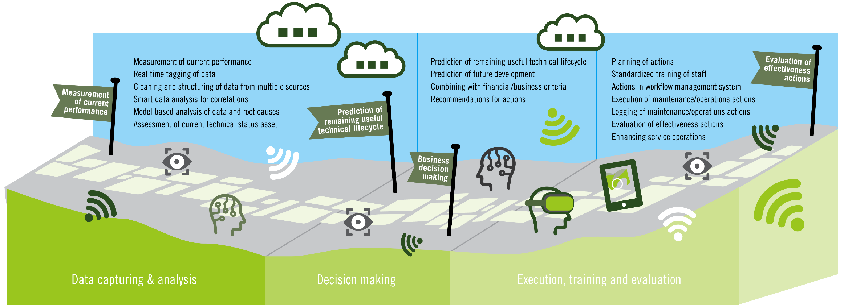

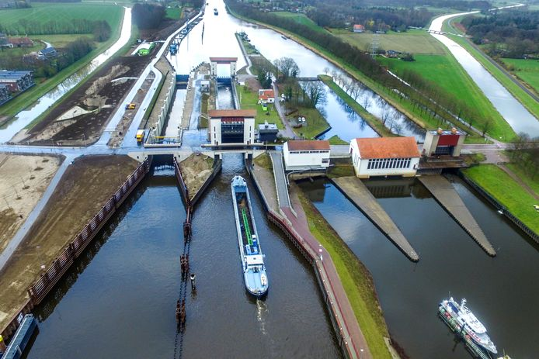
VIA APPIA
VIA APPIA:
  Virtual & Augmented reality and Artificial intelligence Partner Programme for
  Industrial Applications
Objective:
  Industrialisation of VR, AR and AI applications in Asset Management
Industries: High-tech Manufacturing, -Process, and Infrastructure

Slide 3

VIA APPIA: Approach
Main activity
Develop applications and knowledge products in
Communities of Practice
Test applications and validate knowledge products in
Pilots
Save knowledge products and make them accessible in
WCM Loket
Sub-activities
Build Community of Practice
Application and knowledge product pilot A
Record knowledge products
Synthesize joint knowledge and experience
Application and knowledge product pilot B
Develop training modules
Develop Applications
Develop knowledge products*
Application and knowledge product pilot C
Design WCM Loket according to knowledge products
Application and knowledge product pilot D
Launching WCM Loket
Translate new knowledge in knowledge products
Knowledge dissemination
Results
Community of Practice
Tested AI/DA and VR/AR applications
WCM Loket
AI/DA and VR/AR Applications
Validated knowledge products
Knowledge dissemination
Knowledge products
New knowledge
Training modules in WCM Academy
Boost successful operationalization and commercialization for participants.
* AI/DA and VR/AR applications lie at the core of VIA APPIA. Knowledge products are recommendations that allow the effective development, implementation and use of these applications. Knowledge products can take several forms - e.g. whitepapers, guidelines, toolkits, training modules etc.

Slide 4
VIA APPIA: overview of topics and applications
AI Communities of Practice
  CoP 1: General failure prediction model
  CoP 2: Central data management facility
  CoP 3: AI based tool for capturing local expertise
  CoP 4: Automated problem detection and recommendations
  CoP 5: Automated parameter selection per failure mode
  CoP 6: Anomaly detection based on healthy data
VR/AR Communities of Practice
  CoP 7: Over the shoulder support using AR
  CoP 8: Centralized platform to connect AR devices consistently
  CoP 9: Training using AR
  CoP 10: Site Inspection using AR
  CoP 11: Scalable and on demand training approach using VR
  CoP 12: Implementation framework for VR/AR devices
  CoP 13: Legal Framework for VR/AR devices

Slide 5
AI Challenges
  Capturing knowledge by internal or external experts
  Cleaning & structuring data and the synchronization of multiple datasets
  Selecting which datapoints/parameters to use for predictions/decision-making
  Learning from a few complex machines – low volume, high complexity – that function properly
  Building a general predictive model that can be finetuned to specific assets
  Building trust in AI/DA systems to be used in decision-making

Slide 6
AI/DA by IMS for Predictive Maintenance
within VIA APPIA
AI Objective:
  Reduce machine downtime
  Avoid unnecessary or unscheduled maintenance
  Predict upcoming failures
  Schedule proactive maintenance activities
  Increase productivity
  Maintain optimal operational performance
  Industrial Digitalization
Project aim is to develop and industrialize applications of AI within a maintenance & service context

Slide 7
Successful failure prediction
Requirements:
  Access to most possible failure modes
  Extensive failure data from the past
  Maintenance procedures to prevent failures
  Expert knowledge
  Link between maintenance documentation & failure modes
  However, due to the advanced technology of modern industrial machines, failure data is either limited or non-existent.
Is there a way to counteract this limitation?

Slide 8
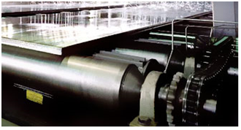
Related past experience - IMS
Prediction of upcoming failures using SCADA data
Fujifilm Living Lab – WCM Project Campione
  Roller Failure prediction including:
    Gearbox Failures
    Electric Motor Failures
    Coupling Failure
    Bearing Failure
    Roller Wear & Tear
    Surface damage/deformation
    Roller Misalignment

Slide 9
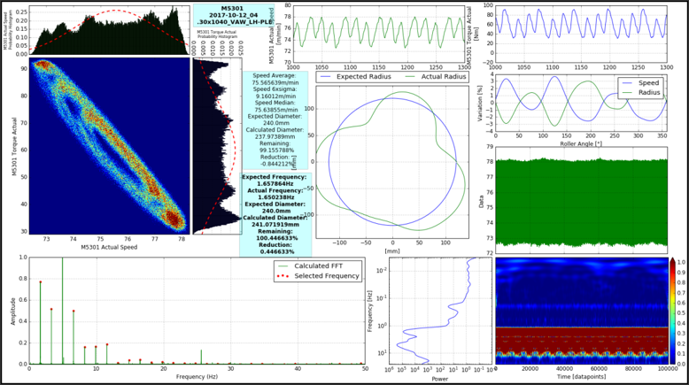
Roller Health Prediction
Predictive maintenance made possible by:
  Big Data handling, processing, and analysis (50GB/day)
  Live Health Monitoring
  Historical Failure Data
Models predicted 100% of upcoming failures & specific failure modes (faulty gearbox, misalignment, etc.)

Slide 10

Related past experience - IMS
Performed owner inspections on Wind farms
  IMMS Enterprise Asset Management (EAM) interfaced with:
    Meteorological (weather) station
    ECN Prediction Models
    OPC on Wind Turbine control room monitoring all Wind Turbine systems
  Including:
Mobile Device for Inspections
  Knowledge based schedule system to assist with:
Scheduling Maintenance & Repairs

Slide 11

Current & Future workings: VIA APPIA
AI Application for Failure Prediction
  Healthy data from target system
  IoT Sensor data
  Execution/operational data
  Data input and processing
  Feature & parameter selection (automated)
  Expert knowledge base
  Machine learning algorithms
  Models to retrain on new failures
  Automated anomaly detection
  Automated classification of failure types
  Automated scheduling of maintenance activities

Slide 12
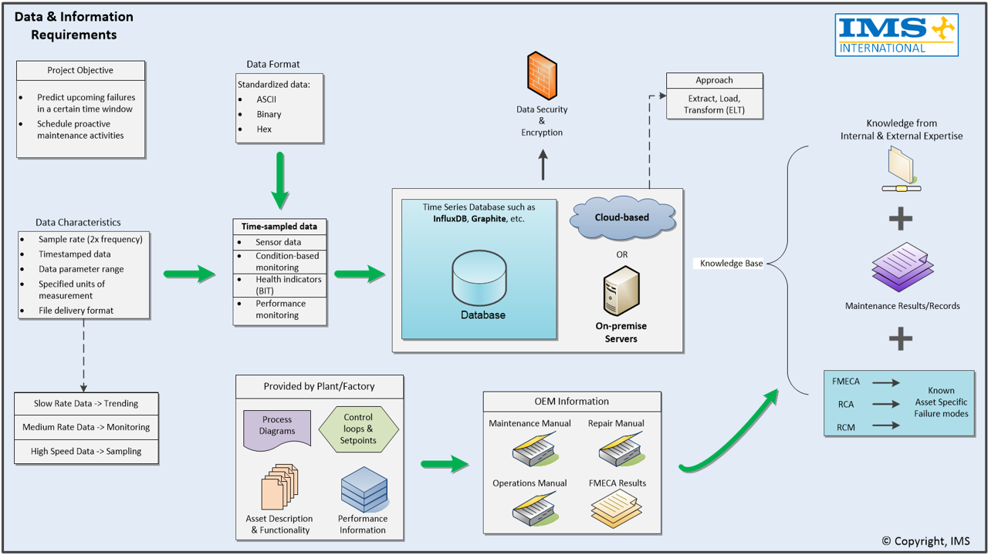
Data is where it starts
Data Overview

Slide 13
Problem Solution
AI Inputs
Multi-class classification problem
- Better accuracy
Anomaly detection
- Required to identify failures for labelling
So what would you imagine the approach to be? Real-time anomaly detection? Time-series forecasting?

Slide 14


Machine Failure Prediction
AI Application to deal with failure data limitations
Equipment-specific
FMECA
Retrain models with newly labelled failure data
Failure Classification Model & RUL
No failure
Anomaly detection model
Healthy sensor data (e.g. Temp, Voltage, Vibration)
Actionable insights
Schedule necessary maintenance

Slide 15
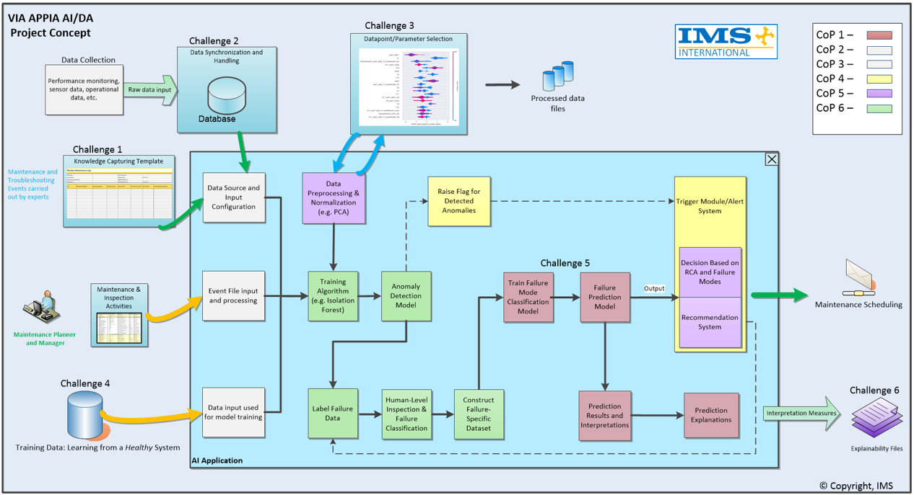
Active Project Concept

Slide 16
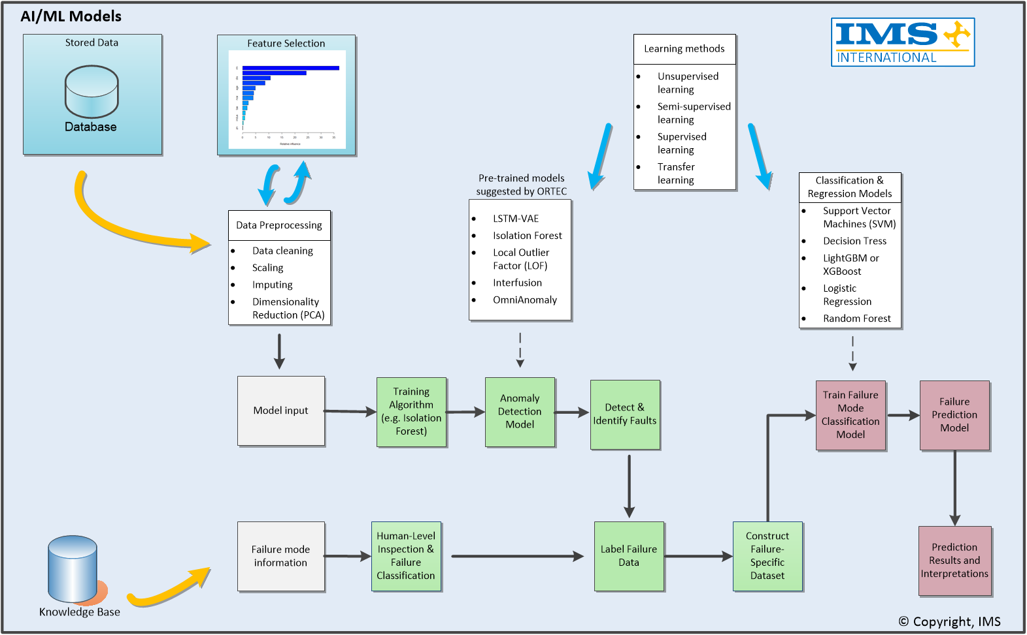
AI Predictive Application

Slide 17

Future Benefits
Generic application
Continuous learning
Failure data remains up to date
from active learning
Automated maintenance tasks
Cost reduction
Reduce unscheduled downtime
Knowledge capturing
Industry Adoption
Predictive Maintenance – Device Insight

Slide 18
Discussion Questions
How reliable is AI?
Will it make mistakes?
Fear of uncontrollable errors?
AI enhances performance and reliability by reducing possibilities for human error!
“If AI automation makes fewer mistakes than its human counterparts, it is an improvement.” – Adrian Goergen

Slide 19
Thank you for your time!
Questions and/or insights?

Slide 20


Contact
In case of further questions or remarks, contact:
  Johan Prinsloo | Managing Director IMS B.V.
  Phone: +27(0)83265 4963
  E-Mail: johan.prinsloo@ims-inter.com
  Jacob Derks | Project leader VIA APPIA
  Phone: +31(0)681881406
  E-mail: jd@worldclassmaintenance.com

