Slide 1
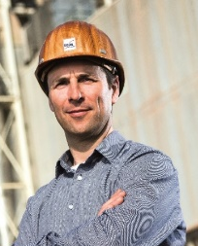
Predictive Maintenance
Status en uitdagingen
6 september 2022
Mark Peters
IJssel Technologie
Platform FME AI For Industry

Slide 2
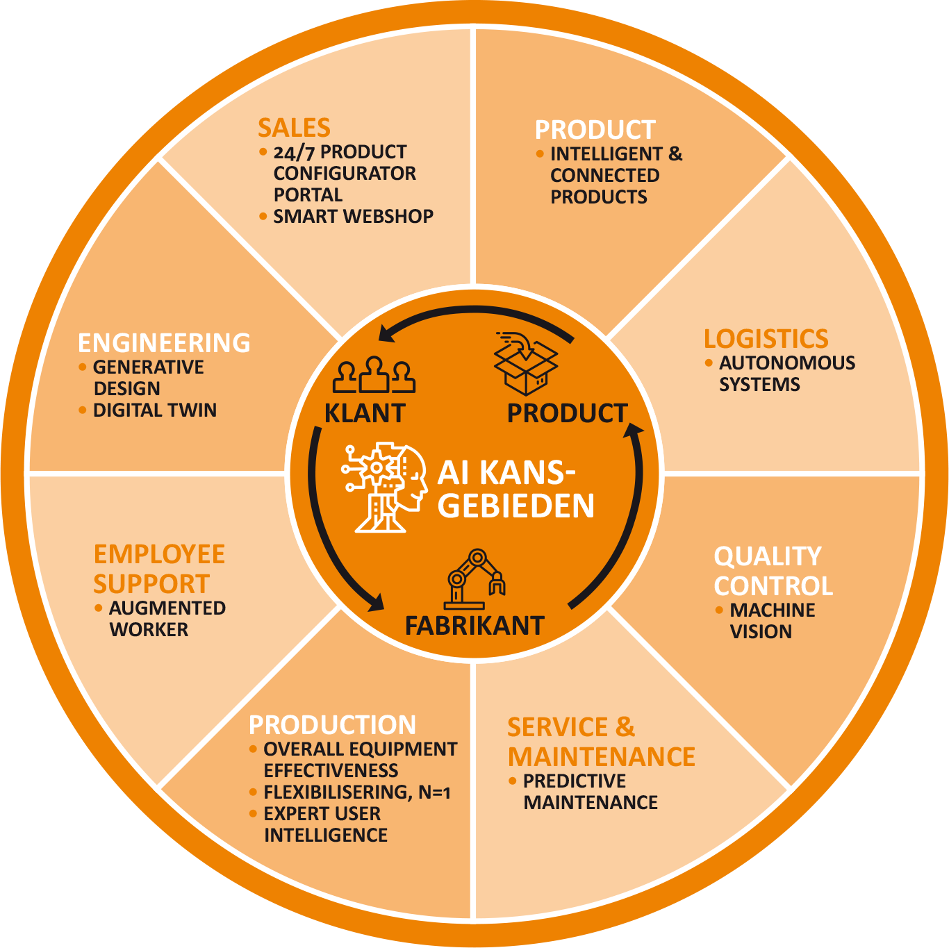
8 Kansgebieden voor AI in industrie
Platform AI for Industry
1
2
3
4
5
6
7
8
9
7
Regiobijeenkomst Noord_6 september 2022

Slide 3
Roadmap AI Predictive Maintenance
Inspiration
What is Ai?
Smart Maintenance
New Technologies
Success stories
Call for action?
Ambition
Dream statement
Relevant KPIs
New Business Models
Scoping
Critical assets
Failure modes
Failure chances
Failure effects
Data collection
Predictive values
Existing data
Smart Sensors
Digitization & computing
Digitization
Edge/cloud computing
Software
Cloud & Connectivity
Cloud platform
5G/BLE/LoRa
API & Integration
Data analytics & Ai
Monitoring
Anomalies
Labeling
Trends
Prediction
Appreciation
Dashboarding
Reporting
Value stating
Follow-up
Celebrating Successes
Elevation
New areas
Elevated services
New Business Models
7
Platform AI for Industry
Regiobijeenkomst Noord_6 september 2022

Slide 4
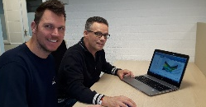
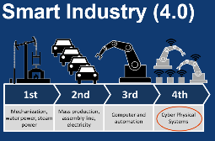
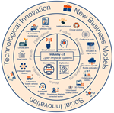
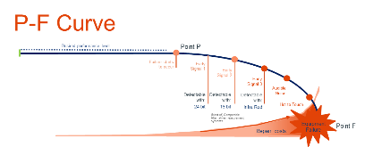
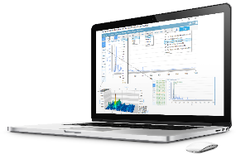
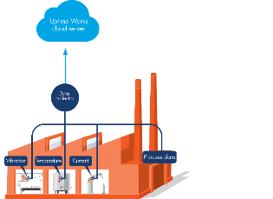
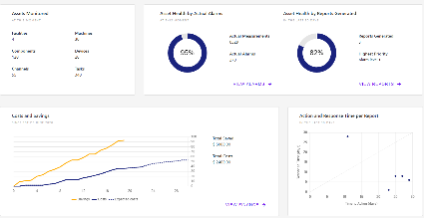
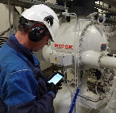
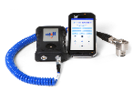
Toelichting roadmap ahv onze gevolgde route
Ambition
Dream statement
Relevant KPIs
Data collection
Existing data
Digitization & computing
Edge/cloud computing
New Business Models
Cloud platform
Ai & Data analytics
Cloud & Connectivity
Appreciation
Inspiration
Scoping
What is Ai?
Critical assets
Anomalies
Elevation
Reporting
New areas
Failure modes
Failure effects
Failure chances
Predictive values
Smart Sensors
Trends
Labeling
Prediction
Monitoring
Value stating
Follow-up
Celebrating Successes
Dashboarding
Elevated services
New Business Models
Software
Digitization
5G/BLE/LoRa
API & Integration
Smart Maintenance
Call for action?
Success stories
New Technologies
UpTime as a service
Tool life as a service
Pumping as a service
Plant Overiew
Asset Health Indicators
Uptime Value
Response time
Regiobijeenkomst Noord_6 september 2022

Slide 5
Roadmap AI Predictive Maintenance
VRAAG 1) In welke stap is uw bedrijf?
Inspiration
What is Ai?
Smart Maintenance
New Technologies
Success stories
Call for action?
Ambition
Dream statement
Relevant KPIs
New Business Models
Scoping
Critical assets
Failure modes
Failure chances
Failure effects
Data collection
Predictive values
Existing data
Smart Sensors
Digitization & computing
Digitization
Edge/cloud computing
Software
Cloud & Connectivity
Cloud platform
5G/BLE/LoRa
API & Integration
Data analytics & Ai
Monitoring
Anomalies
Labeling
Trends
Prediction
Appreciation
Dashboarding
Reporting
Value stating
Follow-up
Celebrating Successes
Elevation
New areas
Elevated services
New Business Models
1
2
3
4
5
6
7
8
9
7
Platform AI for Industry
Regiobijeenkomst Noord_6 september 2022

Slide 6
Kennis en vakmanschap
PDCA
Inspiration
What is Ai?
Smart Maintenance
New Technologies
Success stories
Call for action?
Ambition
Dream statement
Relevant KPIs
New Business Models
Scoping
Critical assets
Failure modes
Failure chances
Failure effects
Data collection
Predictive values
Existing data
Smart Sensors
Digitization & computing
Digitization
Edge/cloud computing
Software
Cloud & Connectivity
Cloud platform
5G/BLE/LoRa
API & Integration
Data analytics & Ai
Monitoring
Anomalies
Labeling
Trends
Prediction
Appreciation
Dashboarding
Reporting
Value stating
Follow-up
Celebrating Successes
Elevation
New areas
Elevated services
New Business Models
Data Analytics/
ML expert
Bedrijfskunde
Vakmanschap
Data engineering
Vakmanschap
Bedrijfskunde
Platform AI for Industry
Regiobijeenkomst Noord_6 september 2022

Slide 7
Next steps en uitdagingen
VRAAG 2) Wat heeft u nodig om de volgende stap te zetten?
Regiobijeenkomst Noord_6 september 2022

