Slide 1
AIRTUB WP 6: erosion MODELLING AND repair recipes
WP 6: Erosion modelling and repair recipe
G. Schepers (TNO Energy Transition/ Hanze UAS)

Slide 2
WP6: Erosion Modelling and repair recipes
Participants:
TNO Energy Transition
Hanze UAS
HZ UAS
NLR
WP 6: Erosion modelling and repair recipe

Slide 3
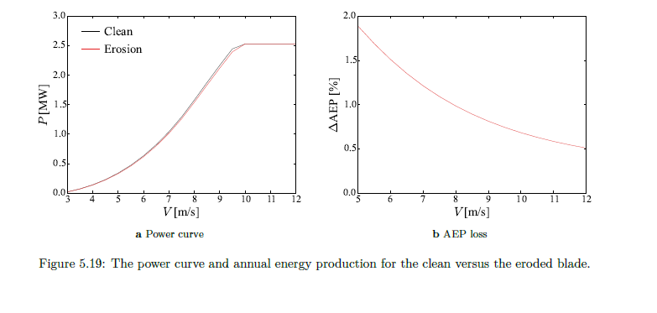
AIRTUB WP6: Goal
To answer the question: “How can we model the aerodynamic loss from a given blade erosion and the resulting loss in wind turbine energy production?”
To classify an arbitrary blade erosion into different categories
To develop a repair strategy for different erosion classes and implement it into a decision tool
From MLW Veraart Deterioration in aerodynamic performance due to leading edge rain erosion LM, DTU, TUDelft report 2017

Slide 4
AIRTUB WP6: sUB Work Packages/Presentations
WP 6.1 Aerodynamics (Presented by kISHORE vimalakanthAN)
WP 6.2 Classification of erosion (Presented by Loek van der LINDE)
Guest presentation: Beatriz Mendez Lopez, Erosion activities at CENEr

Slide 5
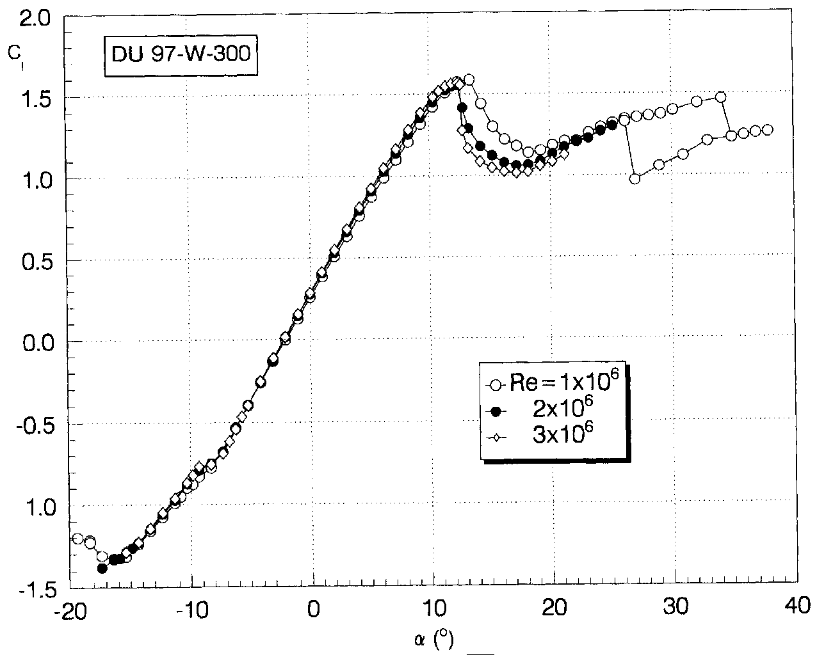
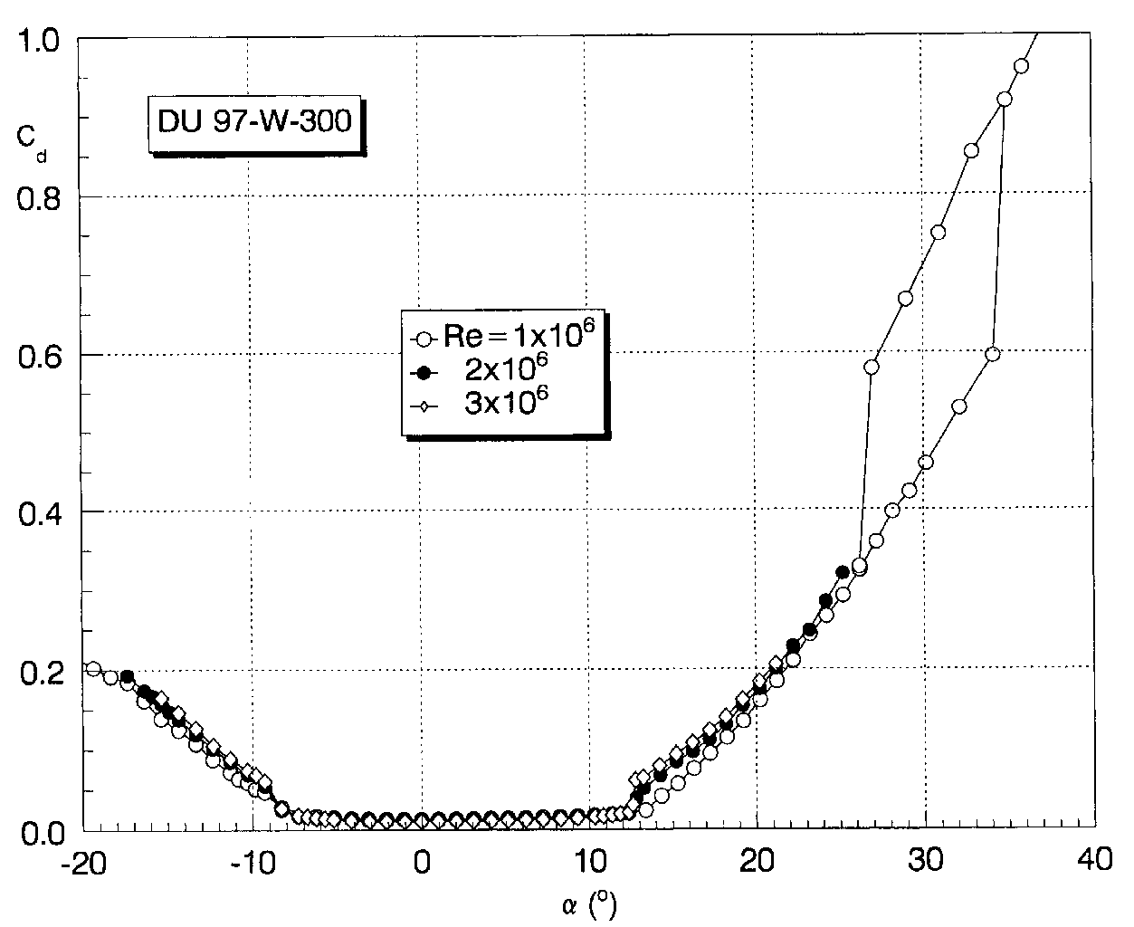
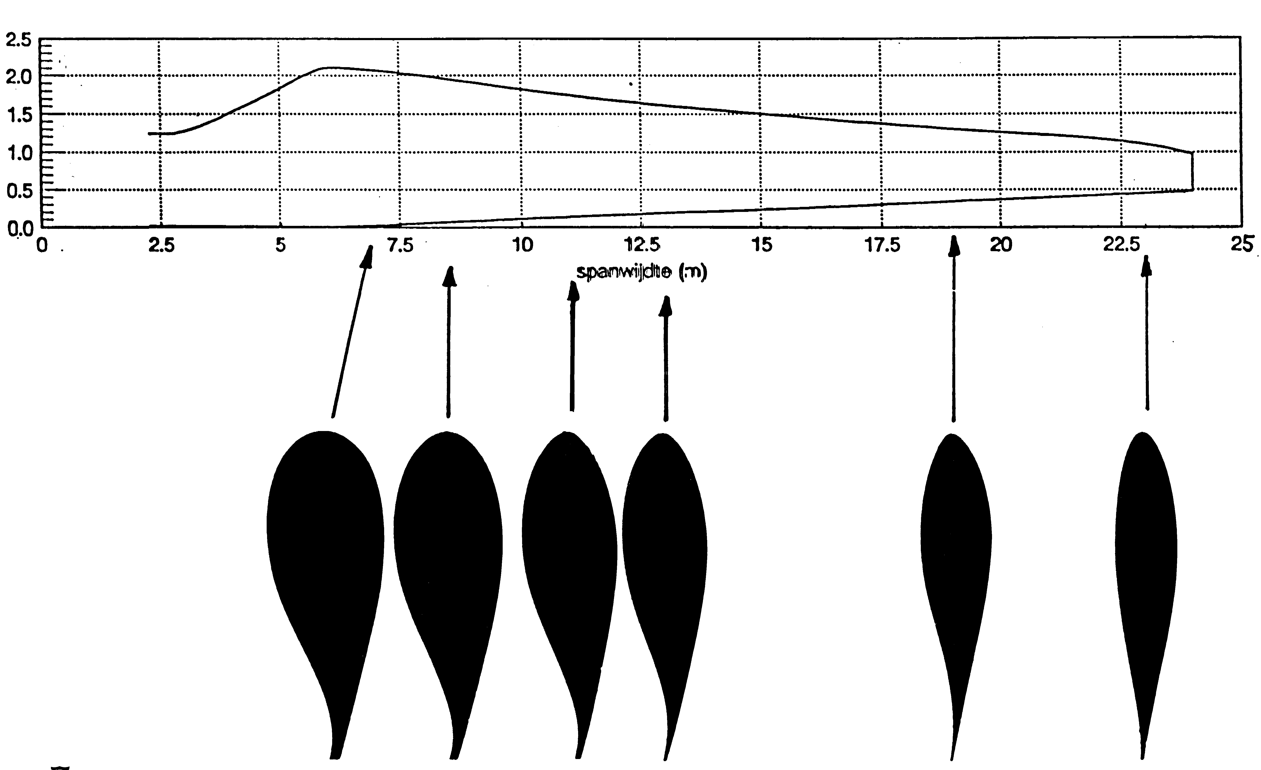
Procedure to determine energy loss from Erosion
BASED ON: BLADE ELEMENT MOMENTUM THEORY (BEM)
Input: lift and drag coefficient c_{l} c_{d} of each element with given airfoil shape as function of angle of attack α.
Determine reduction in c_{l} and increase in c_{d} from erosion with:
Lower fidelity engineering approach RFOIL (2D) with generalised erosion
Higher fidelity CFD approach (2D) with generalised erosion (Kishore)
Higher fidelity CFD approach with actual scanned 3D blade geometry (Kishore)
r
dr
c
36 %
18 %

Slide 6
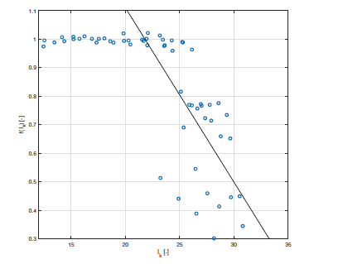
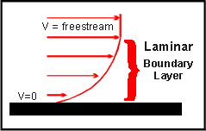
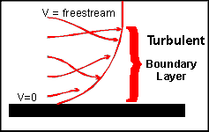
Procedure to determine energy loss from erosion Procedure based on RFOIL
Extension of approach from Sandia Laboratory (based on the publicly available XFOIL code and 1 set of wind tunnel measurements)
Now: RFOIL and more measurements (2 airfoils, 4 Reynolds numbers, measurements performed by Sandia)
Approach and assumptions :
Aerodynamic effects erosion determined by forward shift of boundary layer transition point
Forward shift is calculated from calibration curve f(I_{k}) I_{k} (height and density of roughness elements)
f = 1: No shift; f < 1 Forward shift
Calibrated with wind tunnel measurements
F(I_{k}) calibrated with wind tunnel measurements

Slide 7
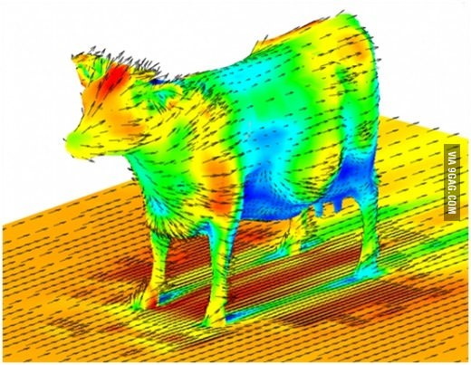
Laminar and turbulent flow

Slide 8
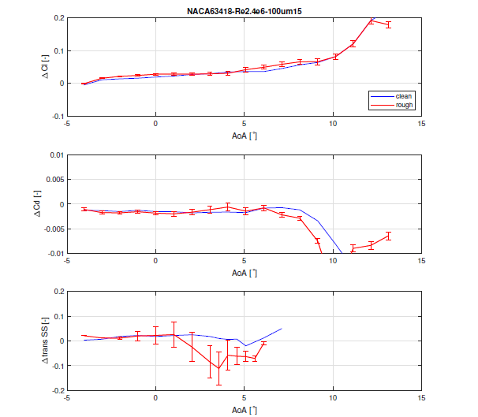
Some results
Procedure to determine energy loss from erosion RESULTS FROM Procedure based on RFOIL
Absolute difference between RFOIL approach and Sandia wind tunnel measurements, Different calibration curves c_{l,} c_{d,} and transition points as f(α) NACA63418 airfoil, Reynolds number 2.4e6.
Roughness relative height, k/c is 123 10 ⁻⁶ Roughness density, d, is 15%.

Slide 9
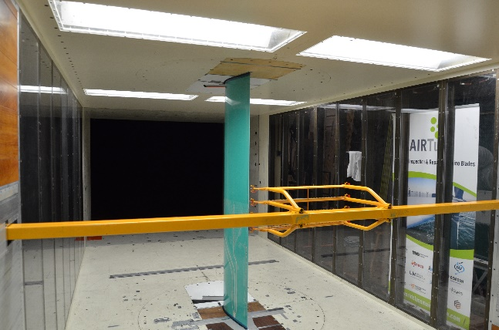
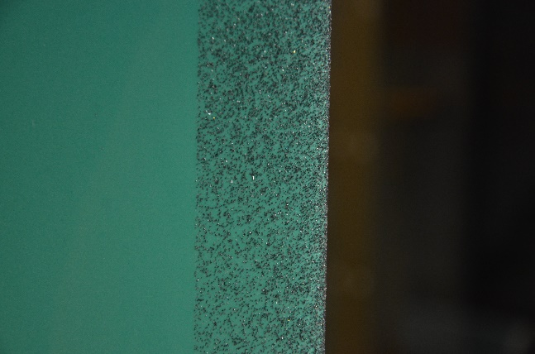
Wind TUNNEL MEASUREMENTS ON cLEAN And ROUGH Airfoils
NLR LST wind tunnel
DU 00-W-212 airfoil (extensively measured in EU AVATAR project for clean conditions)
Grained airfoils instead of sand paper
Clean results differ from the known clean performance measured in AVATAR
Possibly due to some (limited) 3D shape deviations
Still some lessons from the experiment could be useful in follow-up experiments

Slide 10
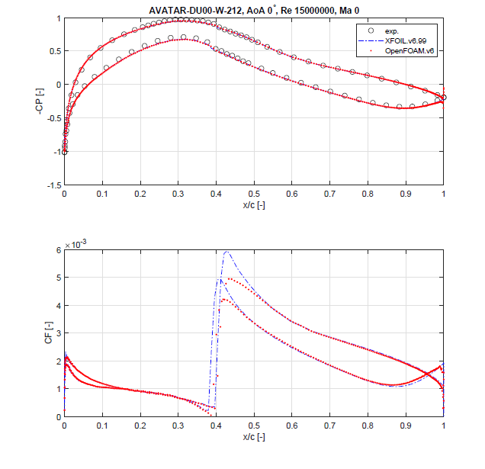
What about HIGH Reynolds numbers?
Reynolds number (Re) is an aerodynamic scaling parameter, determined by size, velocity and viscosity
Boundary layer transition depends heavily on Re
Erosion effects largely determined by transition
Off-shore wind turbines Re > 10 M
(Conventional) Wind tunnel measurements Re < 6M
Within the EU project AVATAR measurements on clean airfoils have been done in a pressurized wind tunnel up to Re =15 M.
XFOIL (RFOIL) can predict airfoil performance at RE = 15 M well; CFD predicts airfoil performance at Re = 15 M poorly
Explanation: boundary layer transition model: e^{N} (XFOIL/RFOIL), SSTLM (CFD)
SSTLM makes use of a calibration curve between turbulence intensity and transition onset momentum thickness Reynolds number Re_{θ,t}
SSTLM relation needs adjustment or SSTLM model itself needs adjustment for higher Re
M. Caboni Validation of high Reynolds number, free-transition, RANS-based CFD simulations using the DNW-HDG's airfoil experiment, TNO 2021 R12123 , Public report, December 2021

Slide 11
conclusions frOM This presentaton
RFOIL can be used to determine the aerodynamic losses from erosion in an efficient public domain approach
Determination of a generalised I_{k} from erosion patterns may need some experience
Calibrate f(I_{k}) for a situation as representative as possible
OR….
Use CFD from generalised erosion or from the actual deformed blade (Kishore)
More research is needed for erosion effects at high Reynolds numbers
More information in [1] [1] .G. Schepers, N. Adema, M. Caboni, K. Vimalakanthan, M.J. Vermeulen WP6.1 Aerodynamic modelling of wind turbine blades exposed to erosion, TNO report, available in draft

Slide 12
WP 6.1 DELIVERABLES
M. Caboni Validation of high Reynolds number, free-transition, RANS-based CFD simulations using the DNW-HDG's airfoil experiment, TNO 2021 R12123 , Public report, December 2021
K. Vimalakanthan CFD transition model for rough surfaces TNO 2021 R12579, Public report, December 2021
K. Vimalakanthan Aerodynamic performance prediction of eroded and rough wind turbine blade sections using RANS CFD. EERA workshop on blade erosion from the perspective of loads, controls and aerodynamics, December 14, 2022 SP4 WORKSHOP on Blade Erosion from the prospective of loads, controls and aerodynamics | EERA JP Wind
I. Lallelis Model Validation for Simulating the Effects of Leading Edge Erosion Hanze/TNO Student thesis report, January 2019.
O. Shamir: Analysis of LM wind tunnel measurements at erosion. Public Hanze report, November 2020
J. Nwaehie: Automation of IRPWIND roughness experiment, InHolland/TNO Student thesis report September 2020
M.J. Vermeulen: Erosion on wind turbine blade wind tunnel test, NLR-CR-2021-516, September 2021
Kisorthman Vimalakanthan, Harald van der Mijle Meijer, Iana Bakhmet, and Gerard Schepers Performance modeling of eroded wind turbine blade using CFD, Preprint for Journal of Wind Energy Science https://wes.copernicus.org/preprints/wes-2022-65/
J.G. Schepers et al: Summary of Airtub WP6.1 results, Available in draft, in review at project partners

Slide 13
Acknowledgements
TKI WOZ For Funding Airtub project
Sandia Laboratory (D. Maniaci) for wind tunnel measurements
Zephyros: Ferry Visser, Jeroen Verschelling for coordination

