Slide 1
Using machine learning to classify LE erosion
Loek van der Linde lecturer & researcher manager Data Science lab @ Joint Research Centre Zeeland

Slide 2
Who?
Lecturer & researcher for IT program
Specialized in software engineering, with a good basis in mathematics and statistics
I love “toying” with immense amounts of data, solving meaningful problems and helping others achieve their goals
Job <3 interests

Slide 3
Who?
Research group Data Science
8 researchers / lecturers
Applied research for organizations in and around Zeeland, if possible combined with students from year 2, 3 and 4
→ Education, research and entrepreneurs (Onderwijs, Onderzoek, Ondernemer)

Slide 4
Why?
Why use machine learning to classify erosion on leading edges of turbine blades?

Slide 5
It is hard
Turbines stand in remote locations
Blades are high up, large and unwieldy
It is hard and expensive to get people to turbines and close enough to the blades to carry out inspection
Though, photography drones made life easier
Image: https://www.dacon-inspection.com/wind-turbine-inspection-and-blade-repair/

Slide 6
It is really hard
Photographing is one thing, but interpreting is another
It is very time consuming and slow
It is fault-prone
There are only so many people who can do it
Image: https://cleantechnica.com/2021/01/05/bladebug-inspects-resurfaces-and-repairs-wind-turbine-blades-remotely/
Notes:
Waarom is het traag? Ga jij even 80 meter blad millimeter voor millimeter nalopen?

Slide 7
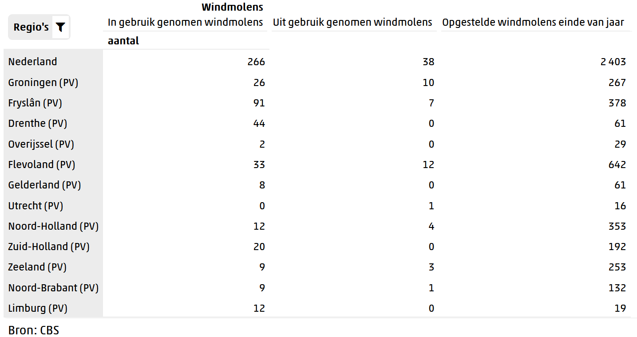
Notes:
Rekensommetje. Ongeveer 3500 turbines incl op zee. Stel 10% van je turbines moeten elk jaar gecheckt worden, en een check duurt 1 dag, dan moet je door het jaar heen dus 1 turbine per dag volledig kunnen checken.

Slide 8
It will become even harder
Amount of turbines will grow rapidly
Current energy price crisis might be push for even more turbines
Severe employee shortage already
Image: https://windopzee.nl/onderwerpen/wind-zee/waar/

Slide 9
Wouldn’t it be nice…
To have a drone that…
Can fly to a turbine
Scan its blades
Automatically detect and classify erosion
Start repairs on the blade

Slide 10
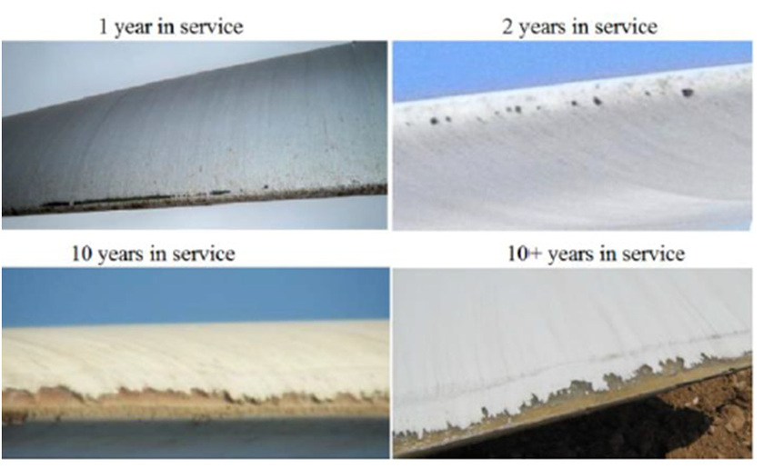
One small problem
What are the classes of erosion?

Slide 11
Work Package 6.2 – Classification of arbitrary data into categories
Class | Name | Depth (mm) | Area (mm)
1 | Small pits | < 0.2 | < 2
2 | Pits | < 0.2 | 2 - 5
3 | Small gouges | 0.3 – 0.5 | 5 - 20
4 | Gouges | 0.5 – 0.8 | 20 - 50
5 | Delamination | > 0.8 | > 50
Images from Gaudern, A practical study of the aerodynamic impact of wind turbine blade leading edge erosion. Doi: 10.1088/1742-6596/524/1/012031

Slide 12
Image: https://www.windpowerengineering.com/fraunhofer-researches-prevent-rain-erosion-turbine-blades/

Slide 13
Work Package 6.2 – Relate gathered data to categories
In other words: data science the heck out of it
Data gathered by laser sensor picked by Work Package 1
Quick summary of setup, fully explained in AIRTuB: towards automated inspection of leading-edge erosion of wind turbine blades by shape analysis, Andrei Anisimov, Ronald Beukema, et al., Proc. SPIE. 11785, Multimodal Sensing and Artificial Intelligence: Technologies and Applications II

Slide 14
Work Package 6.2 – Relate gathered data to categories
In other words: data science the heck out of it

Slide 15
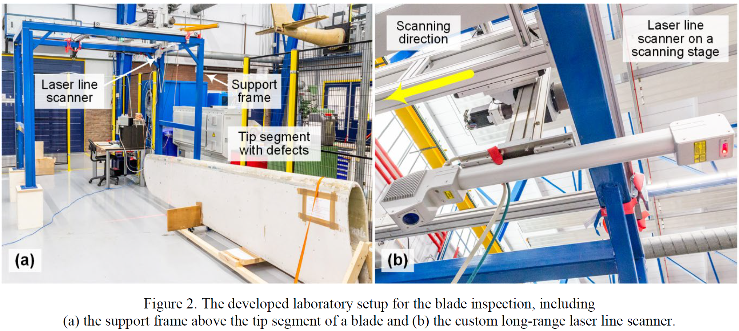

Slide 16
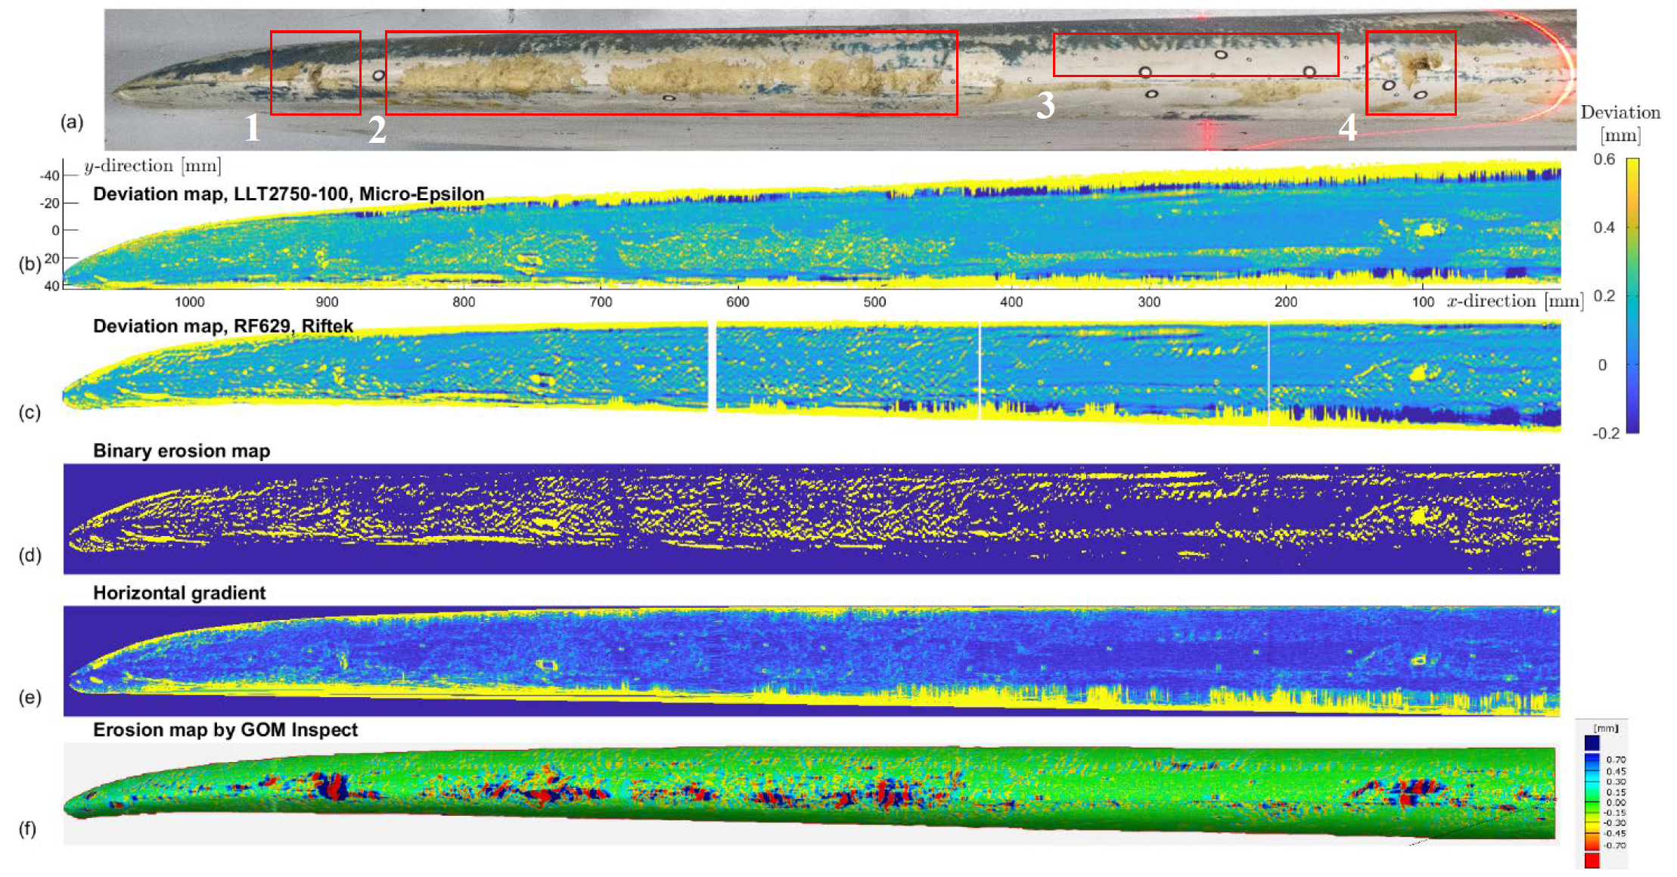

Slide 17
Scans that we used
Simulation of erosion: patterns in 0.2 mm deep paper

Slide 25
Approach
Slices of 10 laser lines +/- 10 millimeter
Three machine learning models:
Logistic regression
Support Vector Machine
Random Forest

Slide 26
Disclaimer
+/- 1 meter of blade
Only 98 slices
Results are limited
Very little data
No category 3/4/5 erosion
Goal: show that approach works

Slide 27
Approach & intermediate results
Train data
Slice 1
Slice 15
Test data
Slice 5
Slice 28
…
…
Train data: 65 slices
Test data: 33 slices

Slide 28
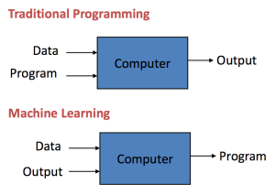
Machine learning – Crash course

Slide 29
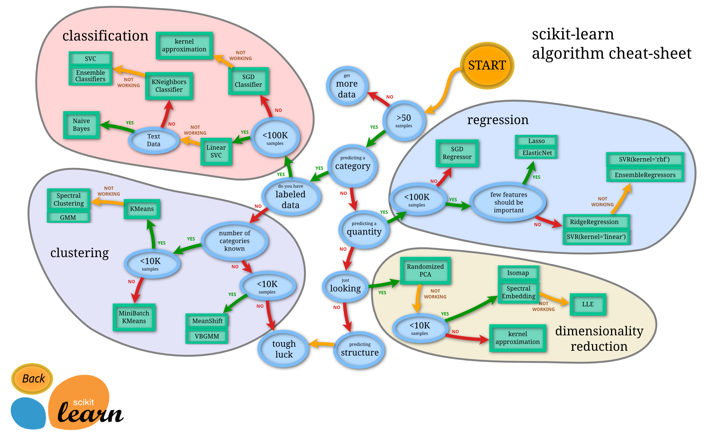
Machine learning
Or: rather complicated function fitting
Three machine learning models:
Logistic regression
Support Vector Machine
Random Forest
Examples are 2-dimensional

Slide 30
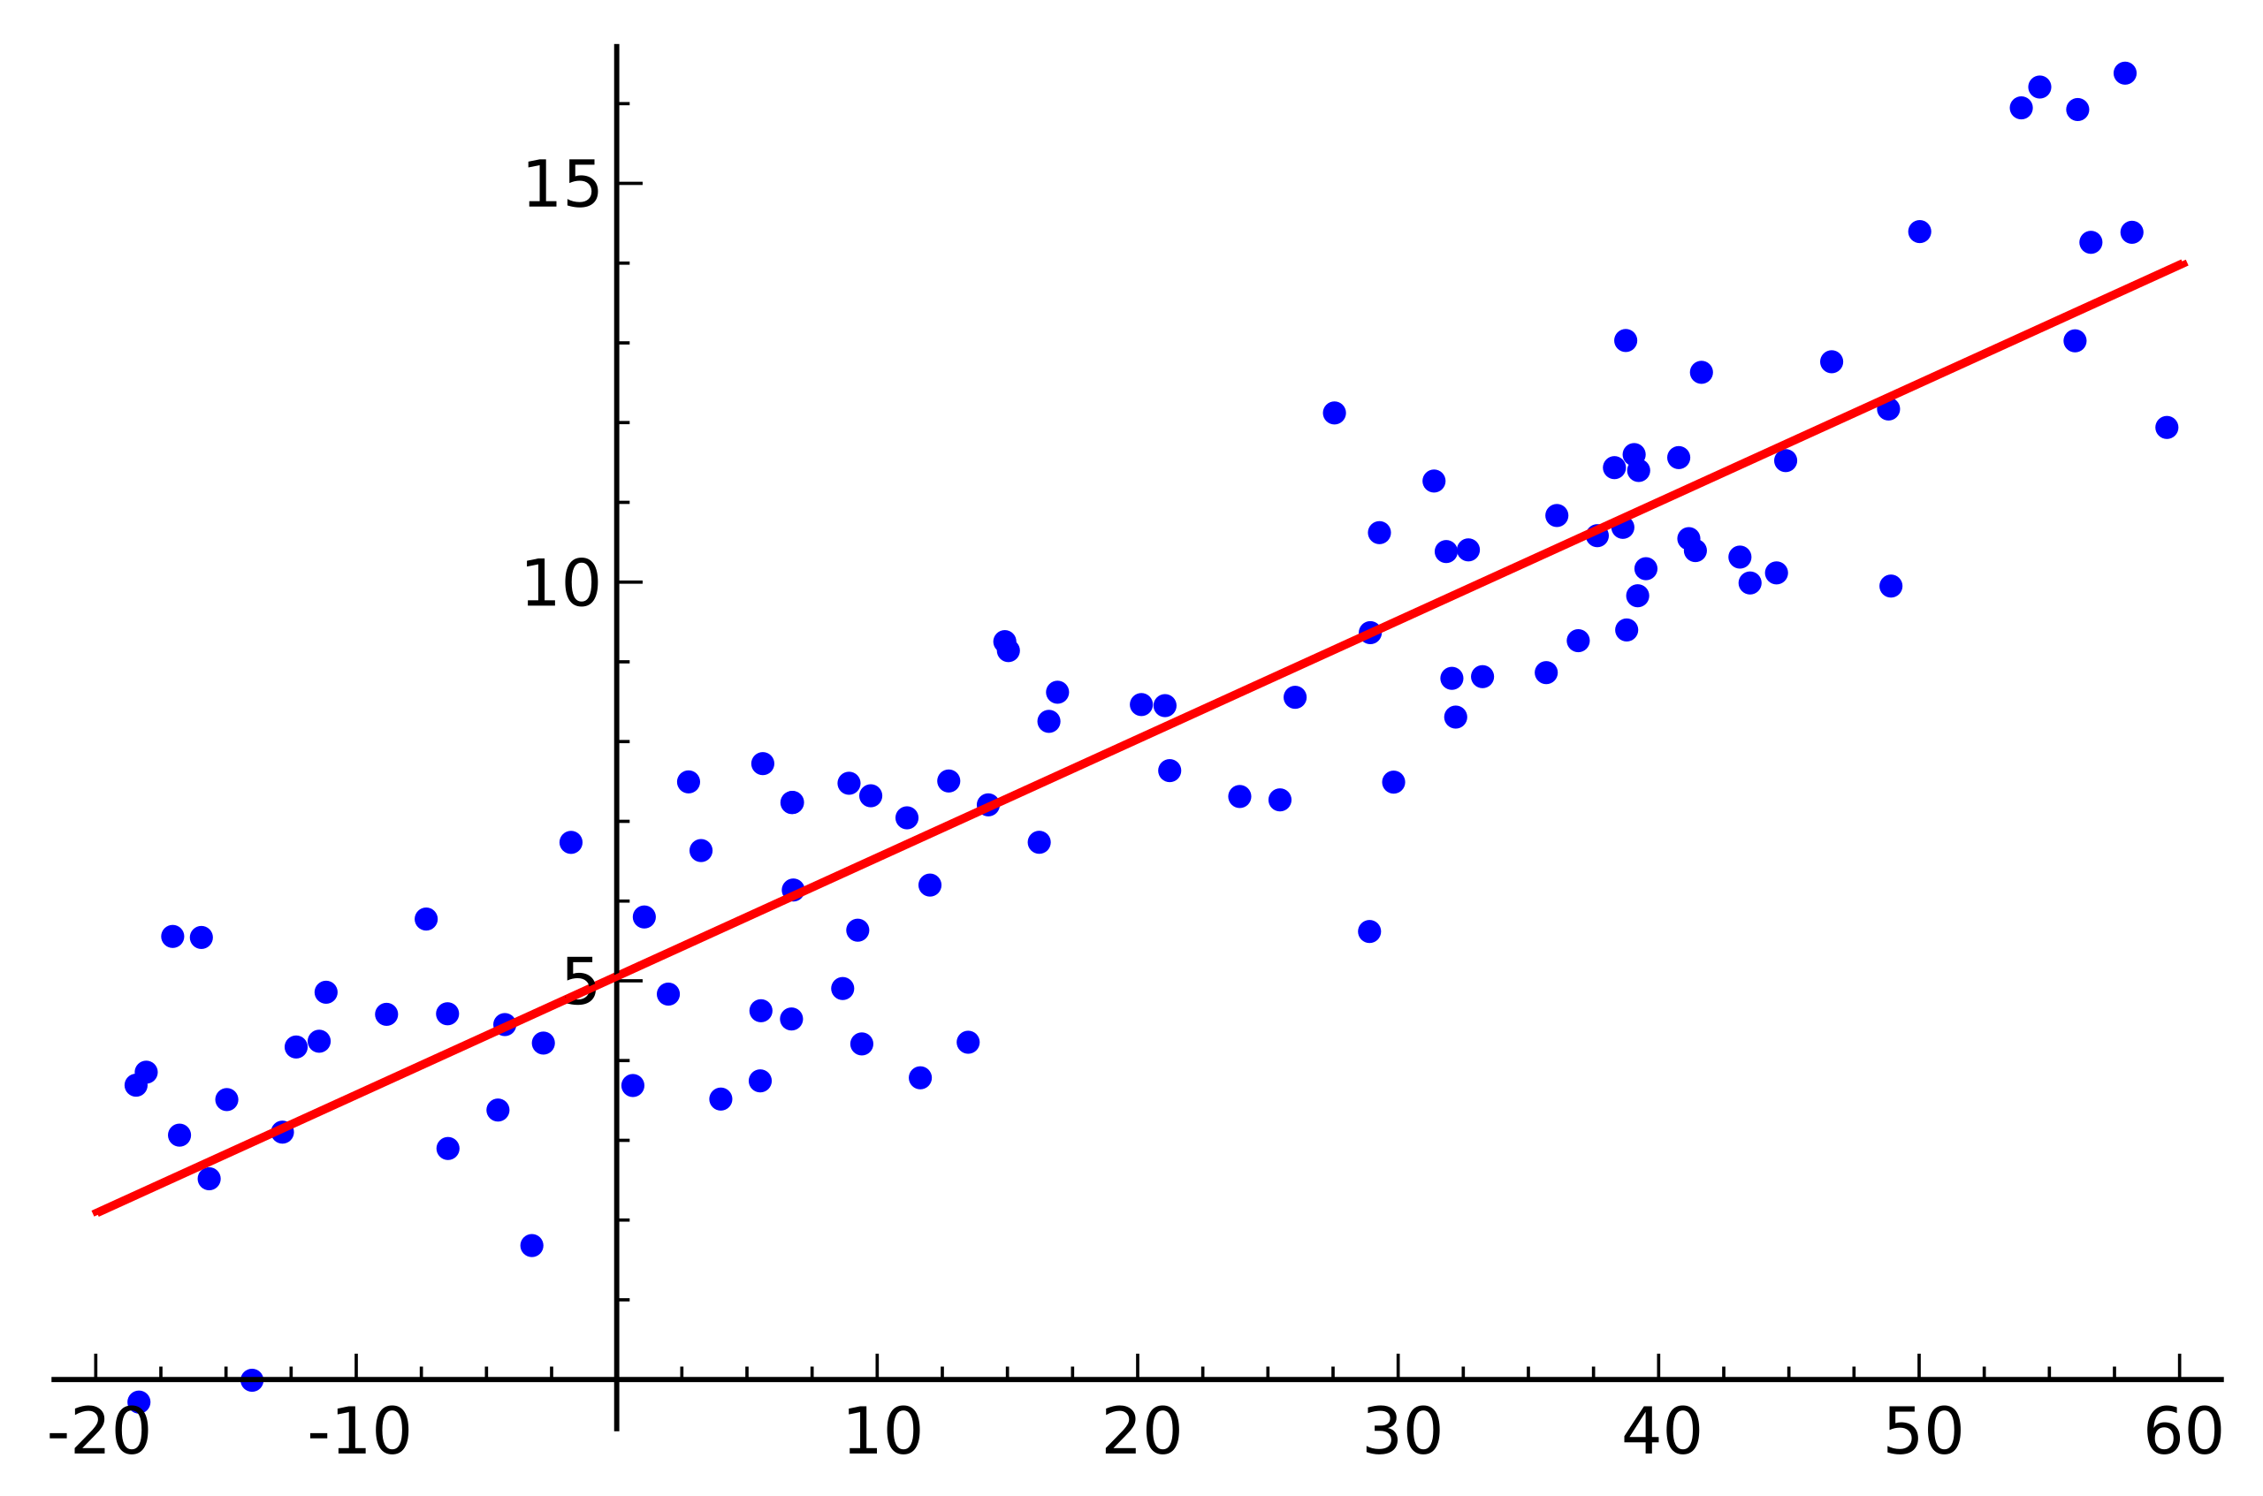
Linear regression

Slide 31
Logistic regression
Class A
Class B

Slide 32
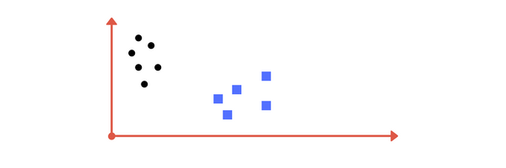
Pubquiz!
Divide the classes with a line

Slide 33
Pubquiz!
Divide the classes with a line

Slide 34
Pubquiz!
Divide the classes with a line

Slide 35
Pubquiz!
Divide the classes with a line

Slide 36
Pubquiz!
Divide the classes with a line

Slide 37
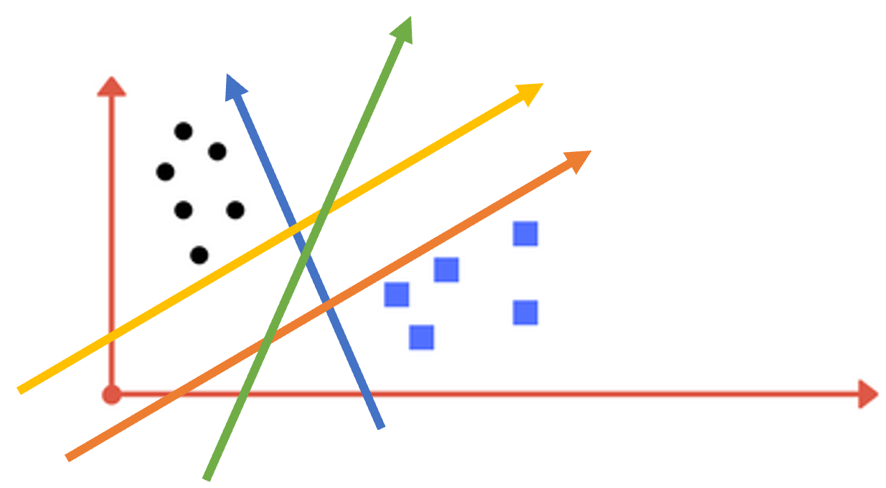
Pubquiz!
Which line is best?
Yellow
Orange
Green
Blue

Slide 38
Pubquiz!
Which line is best?
Yellow
Orange
Green
Blue

Slide 39
Pubquiz!
Divide the classes with a line

Slide 40
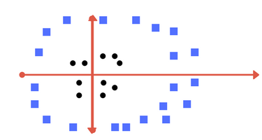
Pubquiz!
Divide the classes with a line

Slide 41
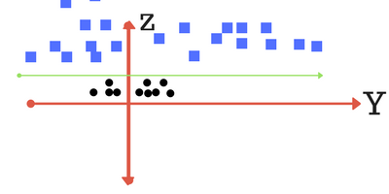
Transform and add a line

Slide 42
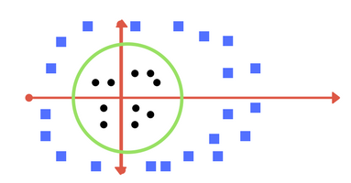
Transform back again!

Slide 43
Support Vector Machine

Slide 44
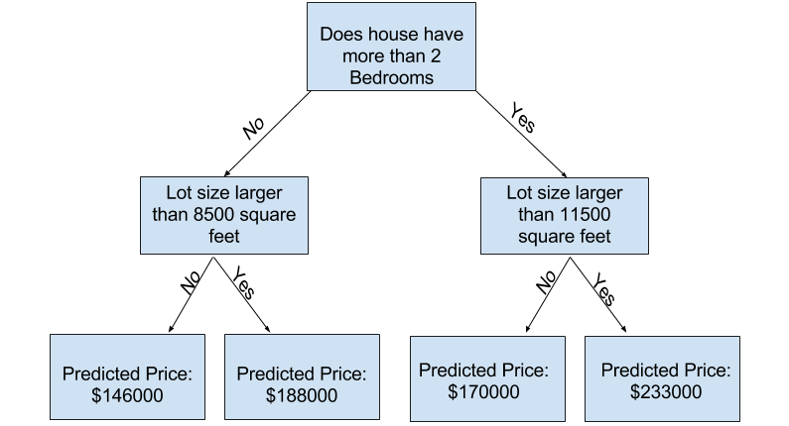
Decision Tree

Slide 45
Random Forest
Consists of multiple trees

Slide 47
Some statistics
1 slice
+/- 75,000 data points
1 category of erosion
75,000 independent variables and 1 dependent variable
In machine learning terms: 75,000 features and 1 target

Slide 50
Zoomed in slice
1 slice
+/- 7,500 data points per line
10 lines

Slide 51
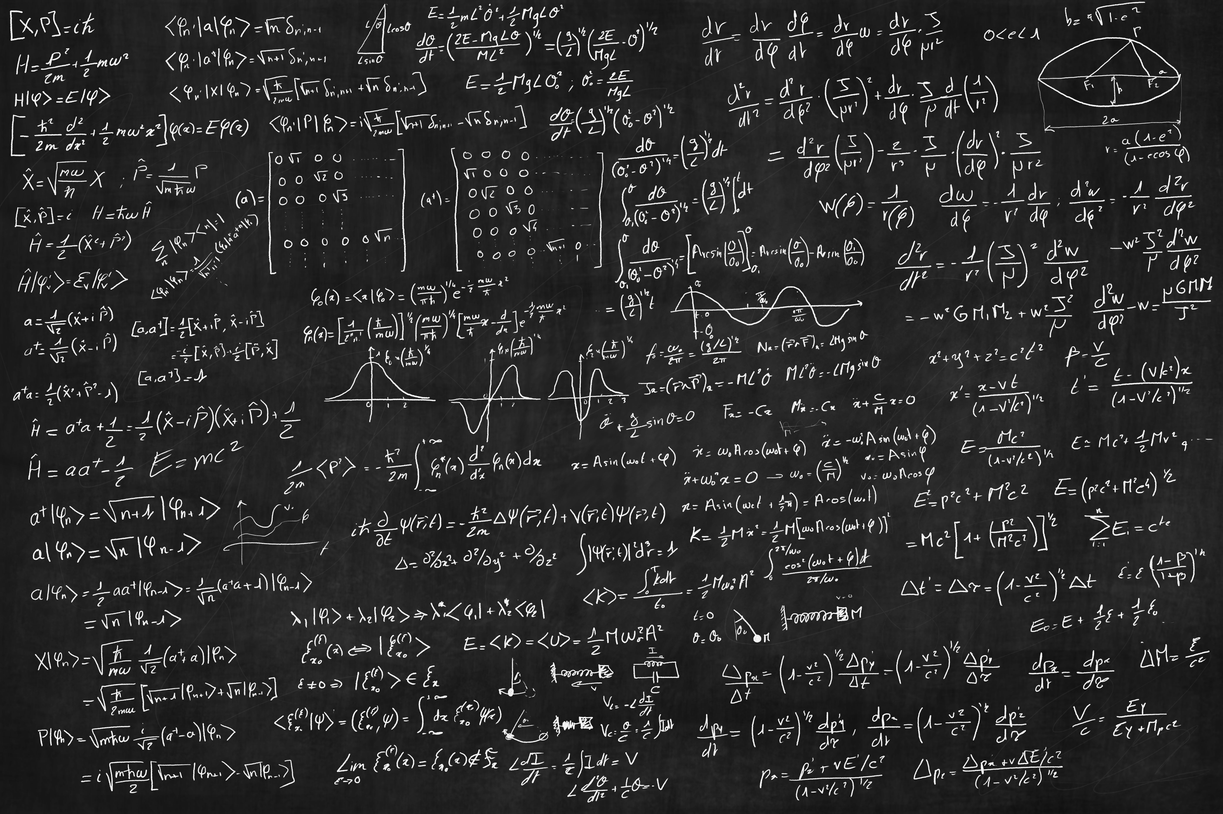
Machine learning for AIRTuB
The model
65 training slices
“training” the model

Slide 52
Machine learning for AIRTuB
Slice | Erosion category | Location on blade
1 | 1 | X = 1500 Y = 230
15 | 3 | X = 72000 Y = 15
74 | 0 | X = 184560 Y = 40
… | … | …
The model
33 test slices
Predicting with the model

Slide 53
The tyranny of the machine learning equation*
*After the Don Petit’s incredible presentation on rocketry: https://www.youtube.com/watch?v=uWjdnvYok4I
Slice | Erosion category | Location on blade
1 | 1 | X = 1500 Y = 230
15 | 3 | X = 72000 Y = 15
74 | 0 | X = 184560 Y = 40
… | … | …
The model
33 test slices
Predicting with the model

Slide 54
The tyranny of the machine learning equation*
*After the Don Petit’s incredible presentation on rocketry: https://www.youtube.com/watch?v=uWjdnvYok4I
Slice | Erosion category | Location on blade
1 | 1 | X = 1500 Y = 230
15 | 3 | X = 72000 Y = 15
74 | 0 | X = 184560 Y = 40
… | … | …
The model
33 test slices
Predicting with the model

Slide 55
The tyranny of the machine learning equation*
*After the Don Petit’s incredible presentation on rocketry: https://www.youtube.com/watch?v=uWjdnvYok4I
Process of
Gathering
Preparing
Validating
… all the data
Takes 80% of all available time
33 test slices

Slide 56
Machine learning for AIRTuB
1 year of meetings, coming up with a process and validating all results
The model
65 training slices
“training” the model

Slide 57
Machine learning for AIRTuB
1 year of meetings, coming up with a process and validating all results
1 hour per 250 millimeter of blade on computer calculation time
The model
65 training slices
“training” the model

Slide 58
Machine learning for AIRTuB
2 year of meetings, creating a process, gathering the data and validating all results
20 seconds of computer time
1 hour per 250 millimeter of blade on computer calculation time
The model
65 training slices
“training” the model

Slide 59
Machine learning for AIRTuB
Slice | Erosion category | Location on blade
1 | 1 | X = 1500 Y = 230
15 | 3 | X = 72000 Y = 15
74 | 0 | X = 184560 Y = 40
… | … | …
The model
33 test slices
Predicting with the model

Slide 60
Machine learning for AIRTuB
+/- 1 millisecond
Slice | Erosion category | Location on blade
1 | 1 | X = 1500 Y = 230
15 | 3 | X = 72000 Y = 15
74 | 0 | X = 184560 Y = 40
… | … | …
The model
33 test slices
Predicting with the model

Slide 61
The tyranny of the machine learning equation*
*After the Don Petit’s incredible presentation on rocketry: https://www.youtube.com/watch?v=uWjdnvYok4I
Experience shows that around 80% of time invested
in Data Science, is spent on actually getting the data
into the model.
The remaining 20% is spent on producing (tangible) results.

Slide 63
Benchmarking
Two “worst case” benchmarks:
Model predicts every slice as not eroded (category 0)
Model predicts every slices as highest available erosion class (category 2)
Benchmarks give insight in performance of models in practice
We want better than “coin flip”

Slide 64
Benchmark – Everything is not eroded
Sample size: 33 slices
 | Class 0 | Class 1 | Class 2
Class 0 | 14 | 0 | 0
Class 1 | 4 | 0 | 0
Class 2 | 15 | 0 | 0
Accuracy: 42.4%
Precision: 42.4%
Recall: 44.8%
Accuracy: how many correct?
Precision: how many predicted classes are actually of that class?
Recall: how many actual classes did we find?
ACTUAL
PREDICTED

Slide 65
Benchmark – Everything is highly eroded
Sample size: 33 slices
 | Class 0 | Class 1 | Class 2
Class 0 | 0 | 0 | 14
Class 1 | 0 | 0 | 4
Class 2 | 0 | 0 | 15
Accuracy: 45.5% ▲
Precision: 45.5% ▲
Recall: 51.4% ▲
Accuracy: how many correct?
Precision: how many predicted classes are actually of that class?
Recall: how many actual classes did we find?
ACTUAL
PREDICTED

Slide 66
Results – Logistic Regression
Sample size: 33 slices
 | Class 0 | Class 1 | Class 2
Class 0 | 12 | 0 | 2
Class 1 | 4 | 0 | 0
Class 2 | 7 | 0 | 8
Accuracy: 60.6% ▲
Precision: 61.0% ▲
Recall: 65.9% ▲
Accuracy: how many correct?
Precision: how many predicted classes are actually of that class?
Recall: how many actual classes did we find?
ACTUAL
PREDICTED

Slide 67
Results – Support Vector Machine
Sample size: 33 slices
 | Class 0 | Class 1 | Class 2
Class 0 | 13 | 0 | 1
Class 1 | 4 | 0 | 0
Class 2 | 7 | 0 | 8
Accuracy: 63.6% ▲
Precision: 64.1% ▲
Recall: 69.1% ▲
Accuracy: how many correct?
Precision: how many predicted classes are actually of that class?
Recall: how many actual classes did we find?
ACTUAL
PREDICTED

Slide 68
Results – Random Forest
Sample size: 33 slices
 | Class 0 | Class 1 | Class 2
Class 0 | 14 | 0 | 0
Class 1 | 4 | 0 | 0
Class 2 | 10 | 0 | 5
Accuracy: 57.6% ▼
Precision: 58.0% ▼
Recall: 62.0% ▼
Accuracy: how many correct?
Precision: how many predicted classes are actually of that class?
Recall: how many actual classes did we find?
ACTUAL
PREDICTED

Slide 69
Conclusions
Machine learning
Support Vector Machine works best*
Results aren’t stellar but better than expected
More data = (very very probably) better results
* Technical questions? Please find me and I’ll share code!

Slide 70
Conclusions
Process
Able to classify 5 different categories of erosion
Able to prove workflow leads to usable results
Able to prove that machine learning can detect small patches of erosion
Online processing seems difficult given processing times + energy consumption
Offline/offloaded processing might be good enough

Slide 71
Any questions? Find me here or get in touch!
loek.linde@hz.nl
Want to do a project with us and our students? Let us know!
Martijn.molenaar@hz.nl

