Slide 1
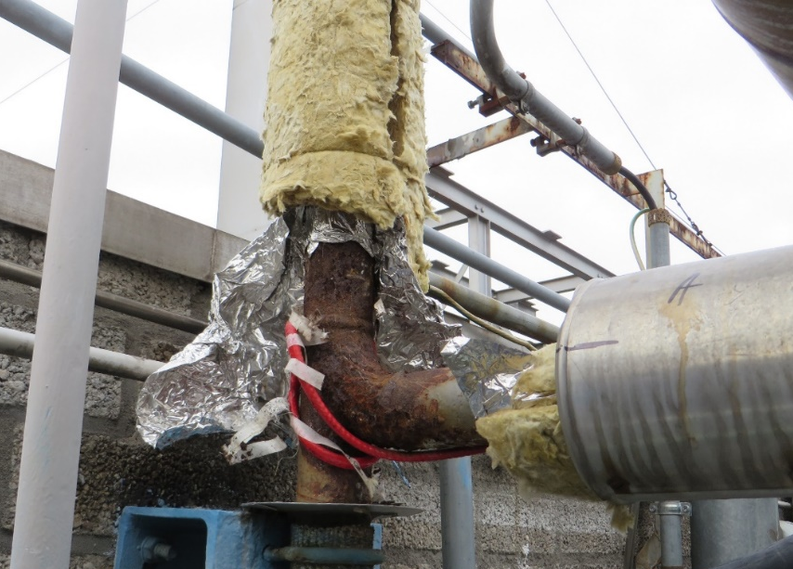
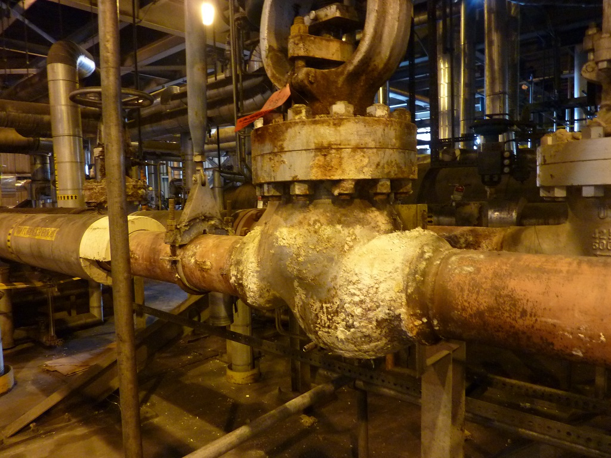
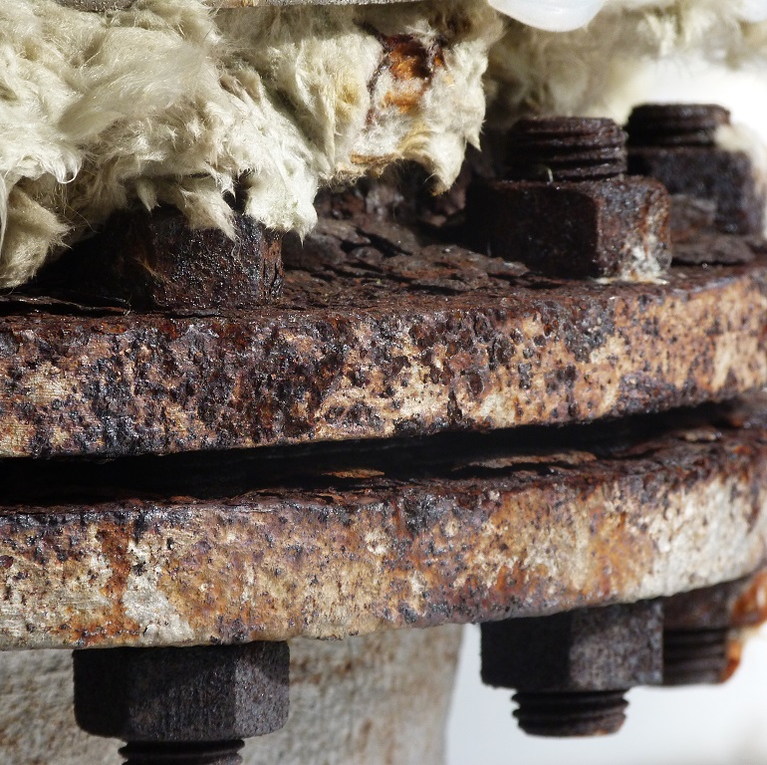
STATUS OVERVIEW.
Notes:
WCM Jaarevent: het gaat om een doorlopende toelichting op de projectresultaten.
Algemene uitgangspunten:
09.00 – 10.00 uur: Presentatie tijdens Inloop en registratie
12.05 – 13.05 uur: Presentatie tijdens Lunch
15.35 – 16.15 uur: Presentatie tijdens Pauze

Slide 2
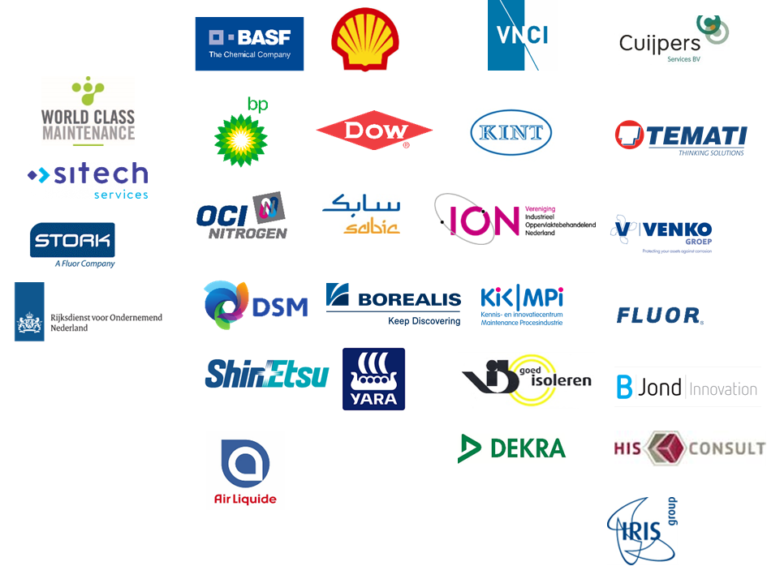
Call for Action / Business Driver
Prevention is better than correction.
Save on failure costs.
Investing in a cost-effective approach from TCO.
Recognisability from management structure
Preventing “trial and error” approach
roadmap
Challenge:
Set-up of a WCM Fieldlab
Development CUI Awareness tool
• Self assessment tool.
Development Best Practice
• Modular set of tools for implementation of CUI management
• Risk based approach
• Based on the ISO HLS structure
• Standard based on hands-on experience of involved companies and the current state of the art in this matter.
Innovations project
• Development moisture- sensoring
• Development sustainable coatings with enhanced CUI resistance
• Development Best Practise CUI conscious insulating
• Determination of earning capacity CUI program for the industry.
Knowledge & Validation Project
Upgrade feasible innovations
• Performance of new detecting techniques
• Performance of new coatings
• Performance of improved insulation techniques
• Performance optimised CUI management as per industry branch
• Branch oriented innovations for proven performance blockers as per industry.
• Implementation service concepts for integrated CUI performance management (isolation, coating, inspection, energy efficiency)
• Awareness w.r.t. CUI
• Evaluation level of robustness in terms of being prepared for CUI
CUI solution:
Modular approach based on maintaining what is good, improving what can be improved.
Using generally proven concepts with regard to predicting corrosion, assessing damage, determining risk, estimating lifespan, controlling costs.
Transparency through independent approach from WCM; a supplier-independent concept.
With the involvement of KINT, ION, VNCI, RVO, SDN
RISC
Sustainable
Control on CUI.
• Self assessment tool.
• Awareness w.r.t. CUI
• Evaluation level of robustness in terms of being prepared for CUI
• Modular set of tools for implementation of CUI management
• Risk based approach
• Based on the ISO HLS structure
• Standard based on hands-on experience of involved companies and the current state of the art in this matter.
• Development moisture- sensoring
• Development sustainable coatings with enhanced CUI resistance
• Development Best Practise CUI conscious insulating
• Determination of earning capacity CUI program for the industry.
Business model:
Risk-oriented, so investment in those areas where it yields best profits.
Taking into account the continuation of those concepts which are already doing well.
Improve together by using each others individual experiences for the better good.
(Potential) partners:
Asset-owners from “BRZO” sector
Isolation and coating industry
Inspection- and service suppliers
2018
2019
2020
2021
2022
2023
Notes:
Roadmap beperkt zich tot het in kaart brengen van de behoefte.
De uitwerking van het plan daar wordt in Ferry’s presentatie verder op ingegaan.

Slide 3
Developments within WCM CUI-approach:
Best practise for Risk Based CUI management
HLS management approach
Process implementation
PDCA improvement loop
Risk based condition forecast
Coating lifetime
CUI Management
Tooling
Assessment
Strategic approach
Corrosion speed
Time To Failure forecast
Inspection effectivity
Case histories
Condition monitoring
New tech assessment
Related activities:
Positioning EFC BP
Notes:
Condition monitoring: focusses onto reporting deviations, generating overview and decision support on installation level.
Strategic approach provides the simple basics for implementing a sustainably funded approach in one’s organization.
The GREEN – recent – developments can be viewed by clicking on the respective square.

Slide 4
Rational monitoring
Application note.
Instruction.
Aspect checklist (completeness)
References.

Slide 5
Strategic approach
Generic setup, using ISO HLS.
Template available for “kick-start”.
Adapted to company vision.
Based on PDCA improvement.
Aligns with compliance req.’s.
Notes:
This approach has been implemented as resulting from the meeting at Delamine @Delfzijl from March 9th 2023.

Slide 6
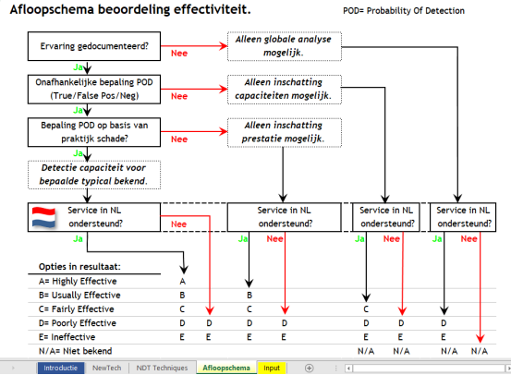
New tech assessment.
CONCEPT.
Overviews various innovations.
Preselected matured tech.
Based on proof from practise.
Based on expert reviews.
Effectivity using API 581 eff.score.
Guidance by decision scheme

Slide 7
Status of affairs:
Development English version for the Best Practise
Best Practise handbook Finalized
Tool prioritization Finalized
Tool risk assessment Finalized
Tool corrosion model Finalized
Gap-analysis tool Finalized
Inspection- selection tool Finalized
Presentation for rollout approach on a site Finalized
Life Cycle Costing tool Finalized
Strategy for CUI management Finalized
CUI Condition monitoring reference model Finalized
Tooling made available through WCM website via WCM Vector; https://www.wcmvector.com/
Development Eco-system
Separate website (EN) with gap-analysis developed Finalized
Q&A / ask the expert still to develop. Being developed
Development expert-group for new technologies Ongoing
CUI-projects
Cooperation with KicMPI on behalf of validation process for CUI-protection-lifetime Ongoing
Best practise isolation condition assessment – commissioning & as-used. Finalized
– incl. EED (Energy Efficiency Directive) assessment. Finalized
Q2 2023
Q2 2023
Notes:
De strategische aanpak voor CUI management, bedoeld als aanvulling op een bedrijfseigen strategisch plan voor onderhoudsmanagement, is in April 2023 uitgewerkt in zowel NL als EN versie.
Het referentie model voor World Class condition monitoring, gebaseerd op de eerder ontwikkelde rationele monitoring aanpak, is in Mei 2023 uitgewerkt voor de toepassing tbv CUI monitoring én in EN versie beschikbaar gesteld.

Slide 8
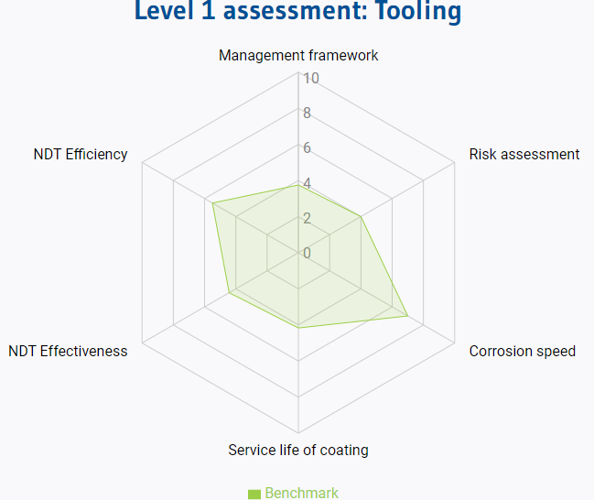
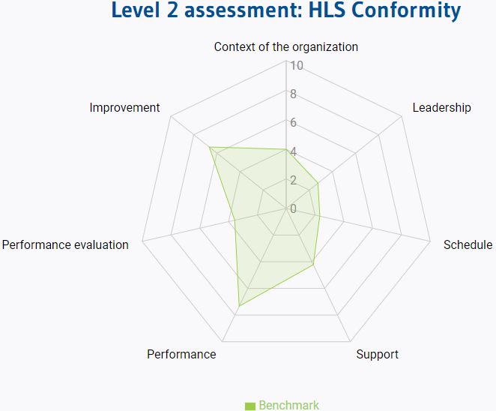
Status with respect to the application of tooling:
GAP-Analysis tooling: 4 companies; 5 audits; all “Chemicals”.
Benchmark score: 4+; exception Leadership and planning. => First profits to be obtained.
Leadership:
Management has implemented CUI management within the strategy
A policy for the rollout of the work process has been implemented.
The policy is available to interested parties and will be communicated.
Powers and roles with regard to CUI management are assigned and communicated.
Schedule/planning:
The method of dealing with risks and evaluation thereof is fixed
Objectives from the approach have been translated into functions and levels.
Objectives are set and followed SMART.
Notes:
Companies: Delamine; Shin-Etsu; Indorama; Sitech.
Aspect leadership and planning, comprises the next elements (click on the 2nd figure to display this as tekst)
Leaderschip:
Management has implemented CUI management within the strategy
A policy for the rollout of the work process has been implemented.
The policy is available to interested parties and will be communicated.
Powers and roles with regard to CUI management are assigned and communicated.
Schedule/planning:
The method of dealing with risks and evaluation thereof is fixed
Objectives from the approach have been translated into functions and levels.
Objectives are set and followed SMART.

Slide 9
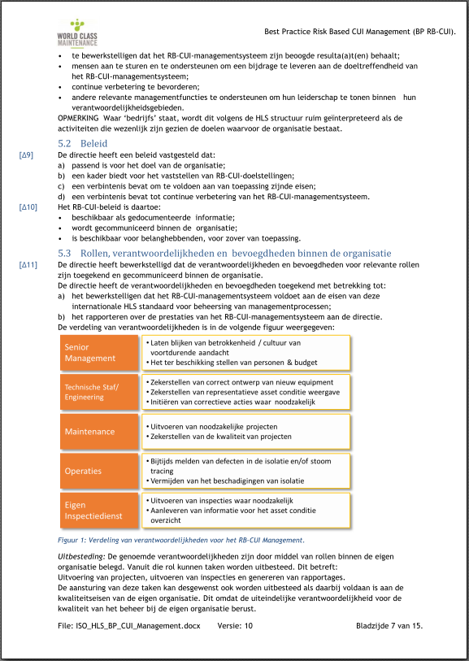
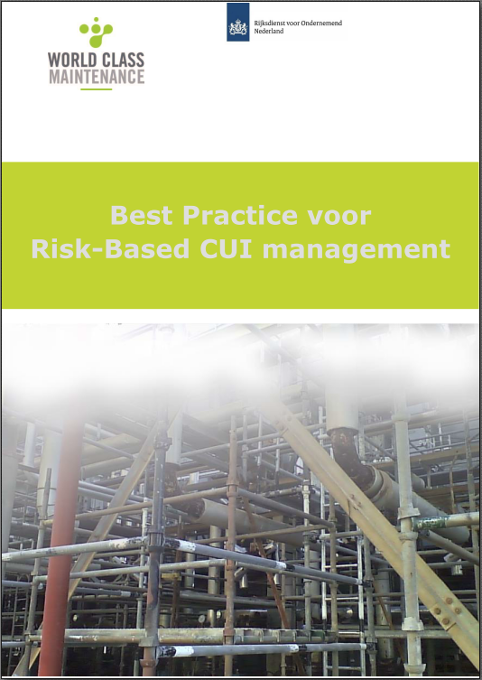
Background
Best Practice available since the end of 2019.
Set-up in accordance with ISO HLS structure.
Audit points included in the design.
Assessment along two lines:
Management line (HLS)
Contents line (Critical elements)
Probability of failure; average / max. / min.
Consequences from std. risk model EN16991.
➔ Risk assessment and earning capacity.
Notes:
Best Practise is eind 2019 ontwikkeld.
De inhoudelijke lijn is in de loop van het project ontwikkeld en bevat de elementen die volgens de vakspecialisten relevant zijn.

Slide 10
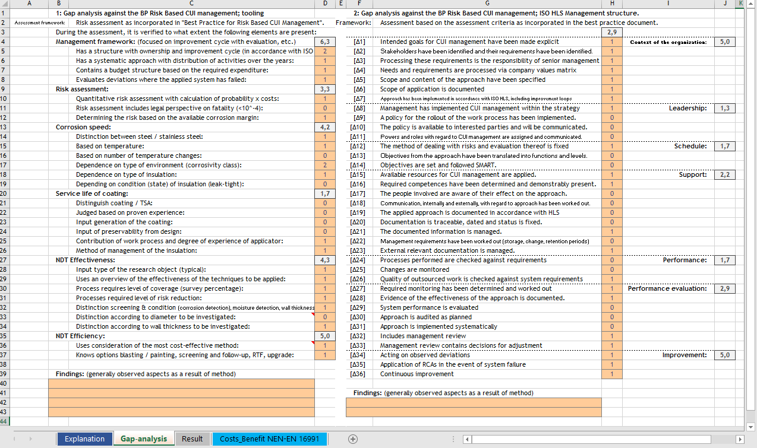
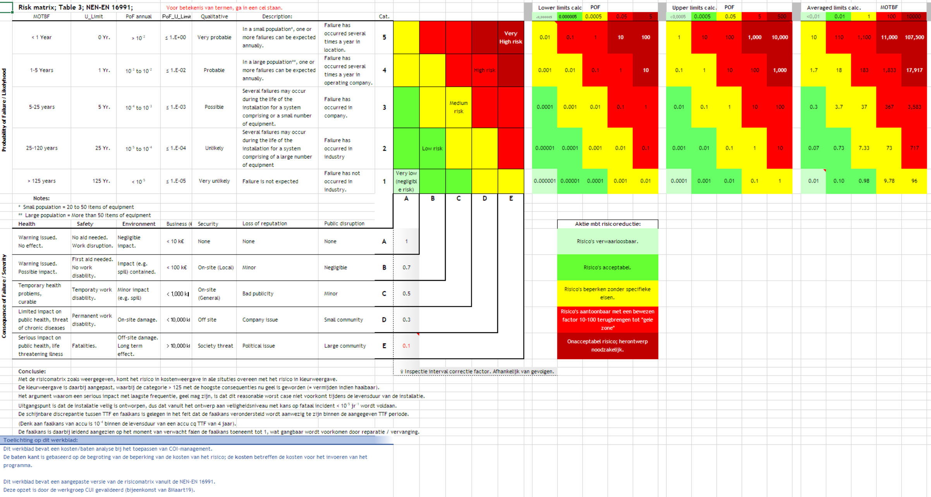
The development and some results.
Choice for limited detail:
“Stoplight” : Good/Average/Bad.
It’s about the insight, not about
discussing whether it’s a 4 or a 7.
Large differences in one company
depending on role/position
Characteristic: “no policy implemented”
Communication is essential.

Slide 11
Next steps in development.
Based on the overview obtained from the internet application.
With that:
Benchmark as steering tool to optimize from overall perspective.
Create awareness to tackle the largest management gaps.
Being able to follow one's own development (trend!) to monitor the effectiveness of the path followed.

Slide 12
Application of the tooling developed:
Application often takes place as originally intended:
Use whatever complements the existing approach
Application condition classification (Huntsman)
Overall Application (Delamine)
Fitting parts as a supplement (Shell Catalysts -BE)
Applying takes time and is not yet a priori time (among other tasks)
From international framework pos. response to open concept (Kaefer)
Introduced as best practice for the EFC55 update.
☑
☑
☑
☑
☑
☑
Notes:
Met name punt 5 biedt de aansluiting voor innovatieve programma’s op technisch gebied.

Slide 13
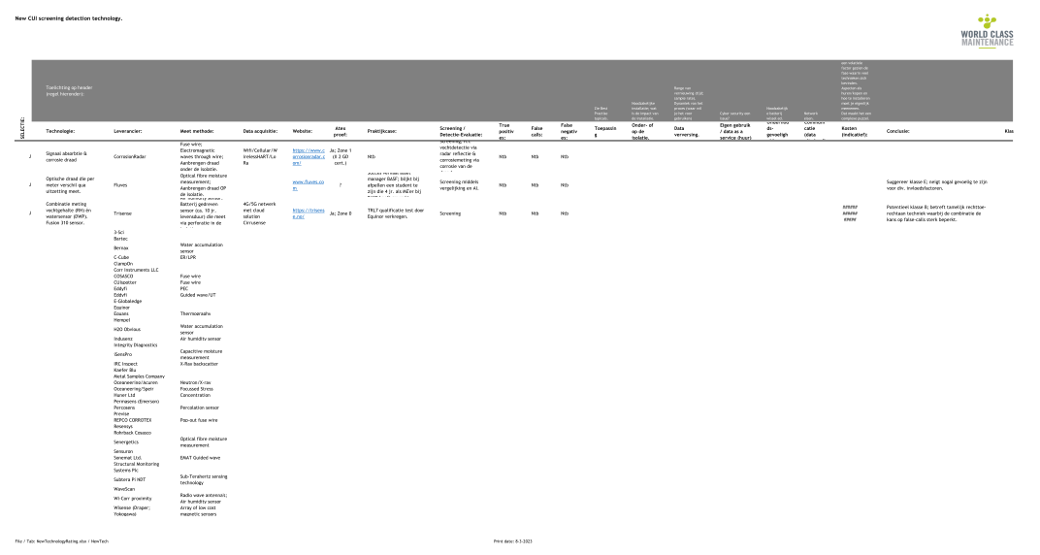
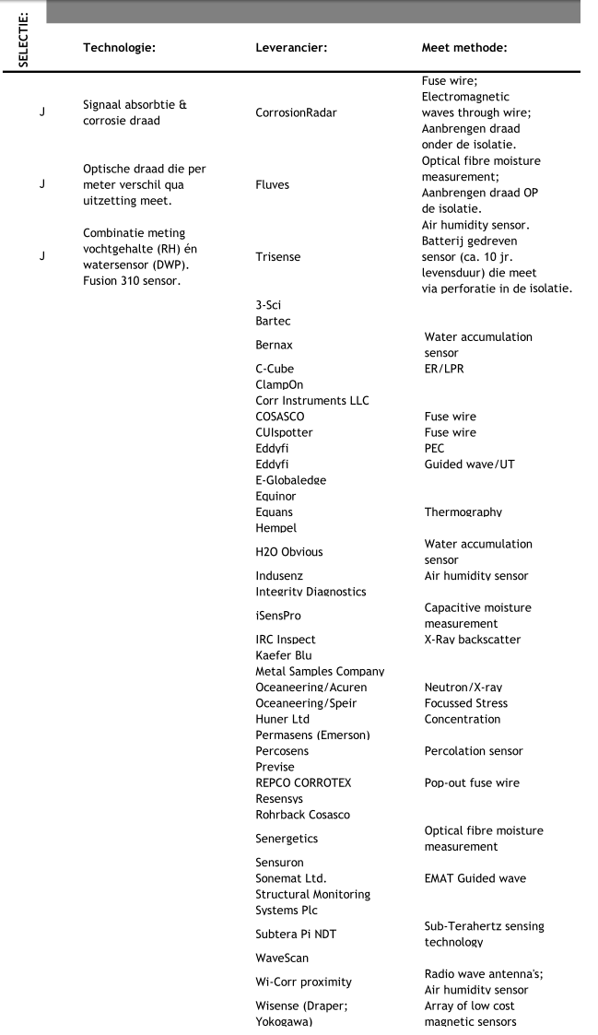
Status wrt the expert group New Technologies:
Currently 5 experts from div. background involved; NDT; Asset owner(2); Corrosion; Asset management
List with new technologies prepared. Pre selection TRL_BRL / Classification / Review / Final.
Rating based upon:
True positives
False positives
False negatives
➔ Add-on to BP RB CUI management.
Notes:
Delamine; Dekra; Shell; Sitech; Stork

Slide 14
The framework for the developments:
Development along 5 main parts. These are:
Design and organization of the COI ecosystem
Development and management of the digital COI platform (website)
Internationalization of the COI platform
Encouraging the use of the developed tooling; optimization
Further development of existing and start-up of new practices
Plan for 2024:
Incorporation of CUPS in the risk based CUI best practise
Integration of Energy Efficiency measures (EED) with CUI management
Validation as per proven practise of new monitoring techniques
☑
☑
☑
☑
☑
□
□
□
Notes:
Met name punt 5 biedt de aansluiting voor innovatieve programma’s op technisch gebied.

Slide 15
The tools; as a reminder:
General access: https://www.wcmvector.com/
Demo Beta tool: https://www.wcm-cuiassesment.com/
Live tool: https://wcm-cuiassessment.com (4 S’s).
Beta tool, new role: Available for training purposes.

Slide 16
Questions?

Slide 17
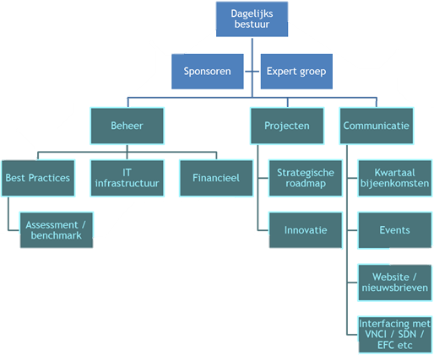
Foreseen developments WCM CUI ecosystem 2024+:
Develop dedicated stakeholder group
PEIBI – initiative
Create organization
Maintain products
Support innovation
Support standardization in approach
Facilitate asset service concepts
CUI support center (tools, knowledge; NDT, coating)

Slide 18
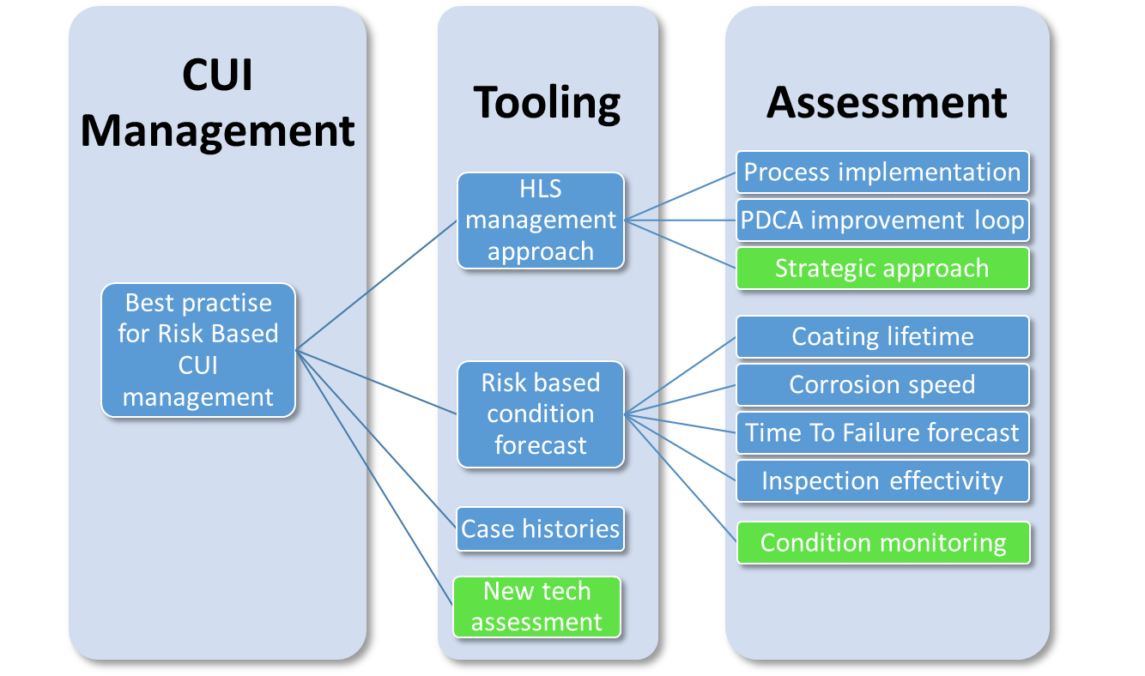
Foreseen developments WCM CUI ecosystem:
On 2024’s menu:
CUPS management
Energy Efficiency Scan
Integrated action plan
New tech effectivity scan
Standardized approach
Certified approach?
Easy-EED reporting (xml)?
Integrated action plan
CUPS management
EED assessment
Notes:
Condition monitoring: focusses onto reporting deviations, generating overview and decision support on installation level.
Standardized approach focusses onto having a stepwise way of working, alike procedures for integrity management.
Practise has shown that there is a need for guidance in “how to apply the available tooling in a stepwise approach”.

Slide 19
Issues of interest:
Administrative reporting load ⬆
Lack of personnel & variability of services
Transparency in compliance
Ensure future proof approach
Build upon solid concepts
Notes:
Upcoming issues:
Increasing reporting load with amount of detail increasing.
How to be ensured that applied approach is future proof (so

